Slide 1
MOLECULAR DYNAMICS: Bcl-xL w/ BIM BH3 domain
Dana Seibert
Vistas in Advanced Computing 2017

Slide 2
Bcl-xL w/ BIM BH3 domain
Bcl-2 Family in charge of homeostasis during apoptosis
B cell leukemia/lymphoma 2
Homeostasis-
Apoptosis- Programmed cell death due to age or damage
One structure: Bcl-X_{L}
Contains BH3 peptide complex
Particularly BIM peptide
Studied crystal structure of human Bcl-X_{L} in complex with BID^{BH3} and BIM^{BH3}
Visualize Bcl-X_{L} in complex with BIM^{BH3}
Notes:
B cell leukemia/lymphoma 2- family of proteins, apoptotic regulators, mediate mitochrondrial outer membrane permeabilization (point of no return), do this by creating disruptions in the membrane thus releasing death-promoting proteins like cytochrome C, Anti-apoptotic proteins (prevent it), like most proteins: have inhibition and activation sites, balance between anti and pro is very important, prevents cancer
Other BH3 peptides: BAD, BAK, BAX, PUMA, SOUL, Beclin, and other BH3 mutants/variants

Slide 3
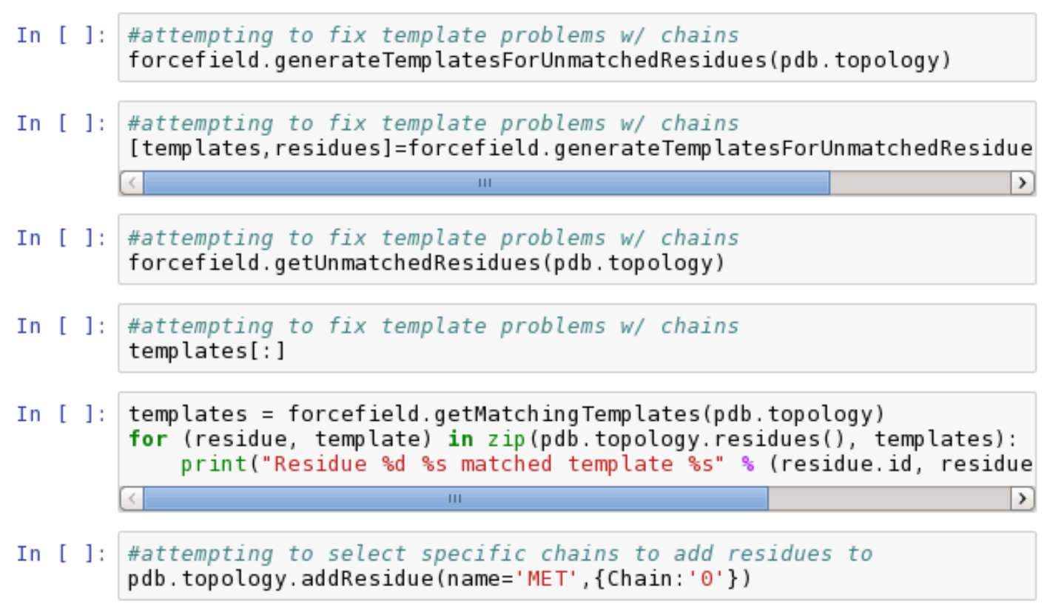
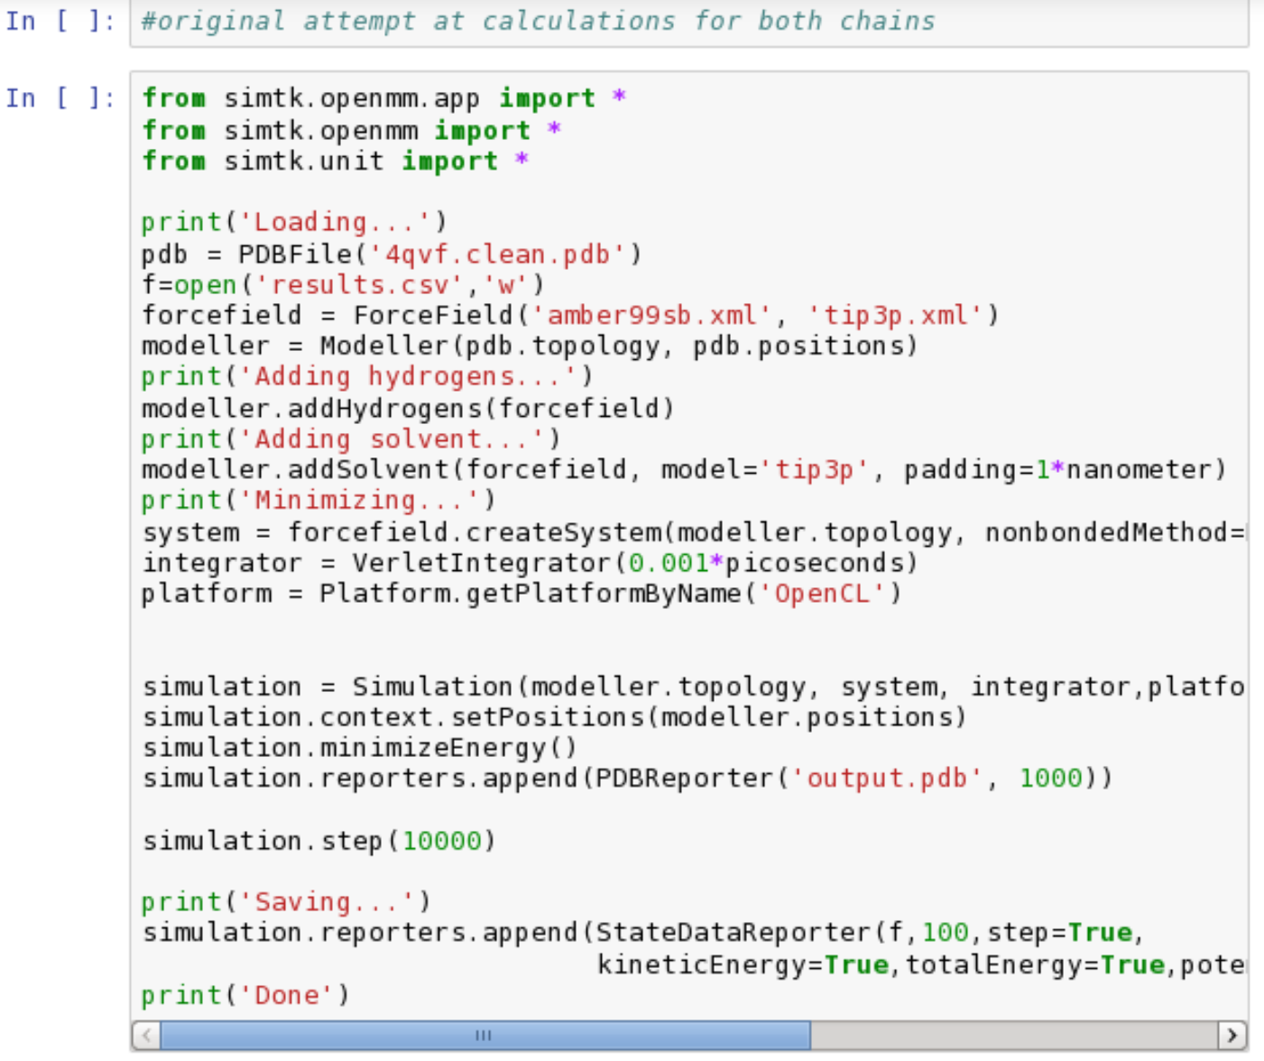
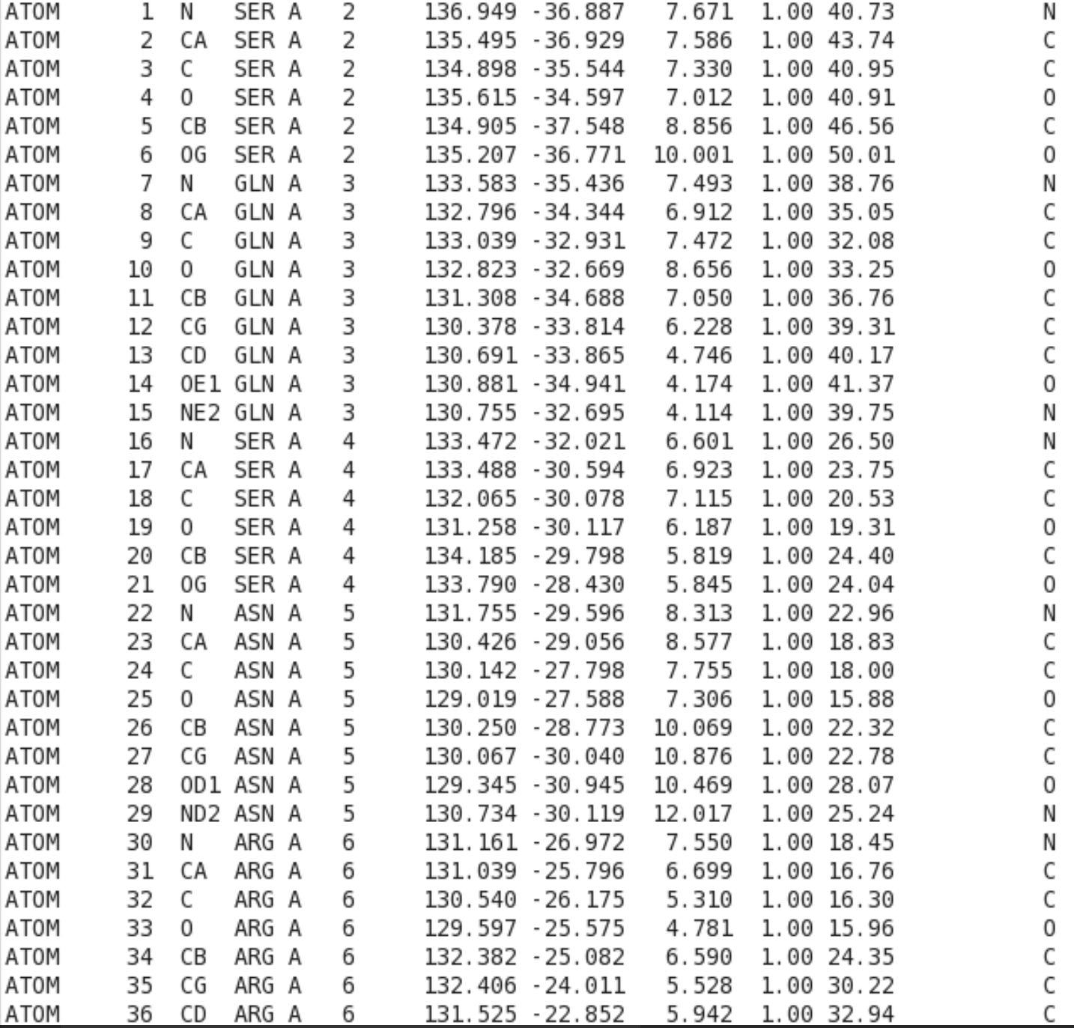
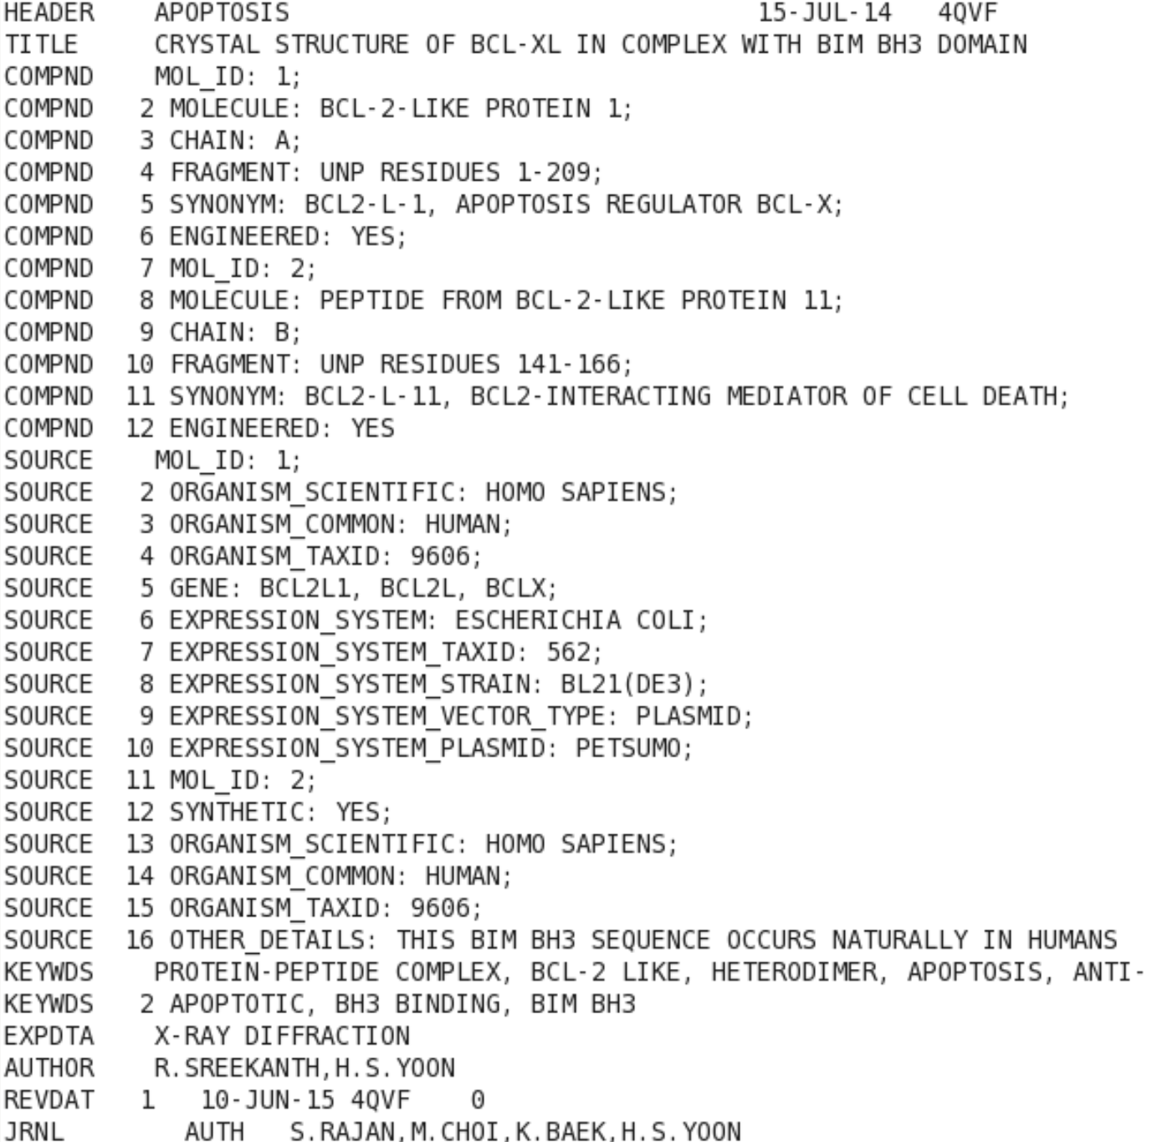
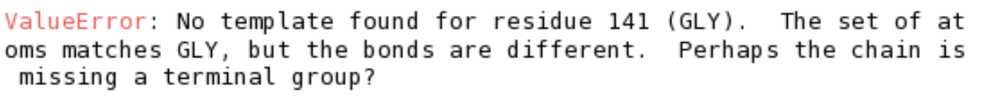
4QVF
Find PDB file from RCSB
Use MobaXterm and server
Clean file
grep “^ATOM” 4qvf.pdb > 4qvf.clean.pdb
Using example code, attempted editing molecule
Didn’t work
Notes:
MobaXterm- similar to PuTTy, but allows for multiple sessions to run at once
Used it for jupyter notebooks and python compiling and running

Slide 4
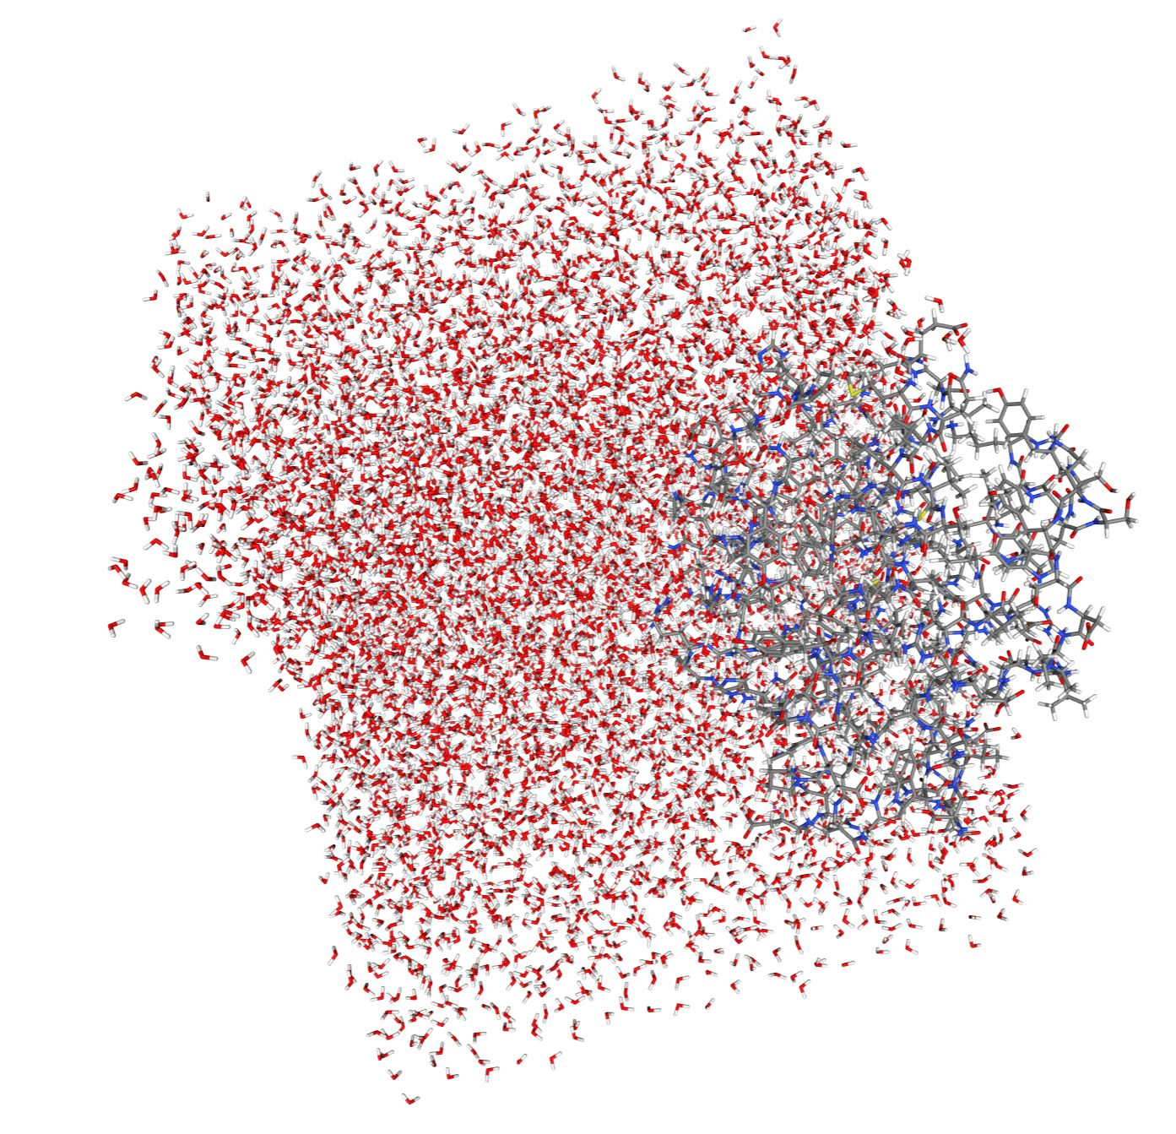
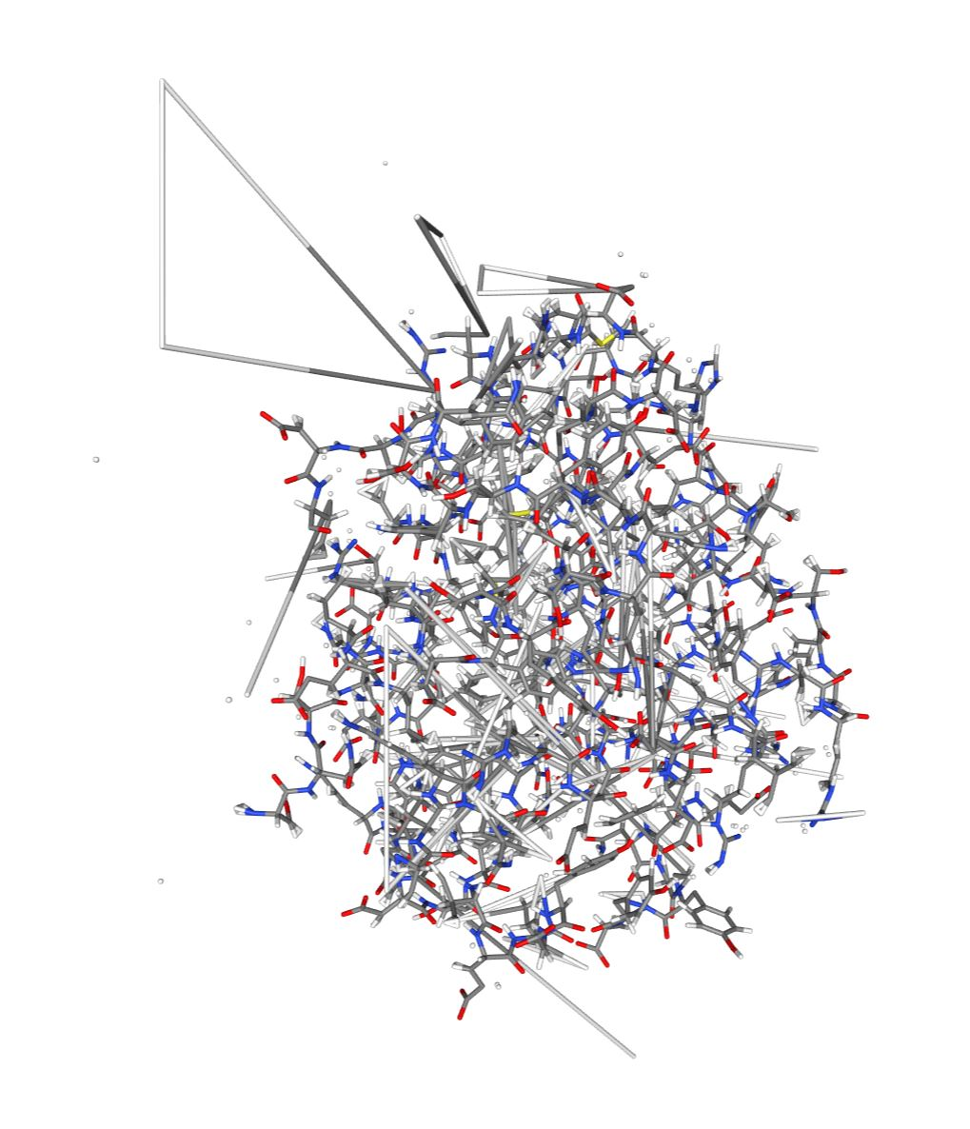
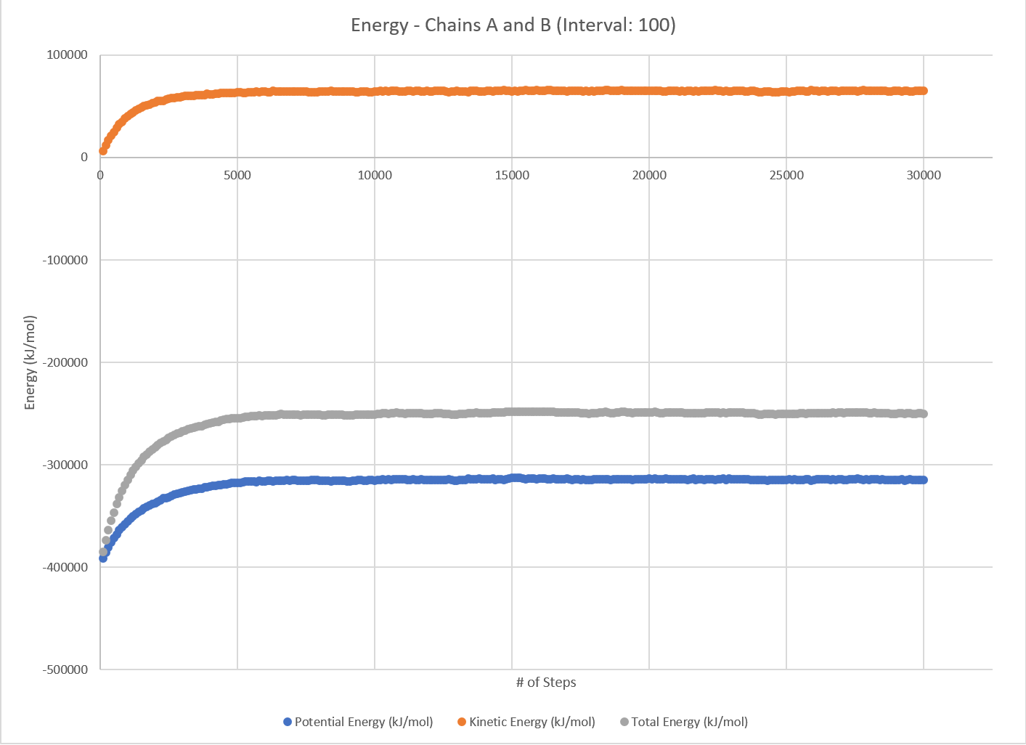
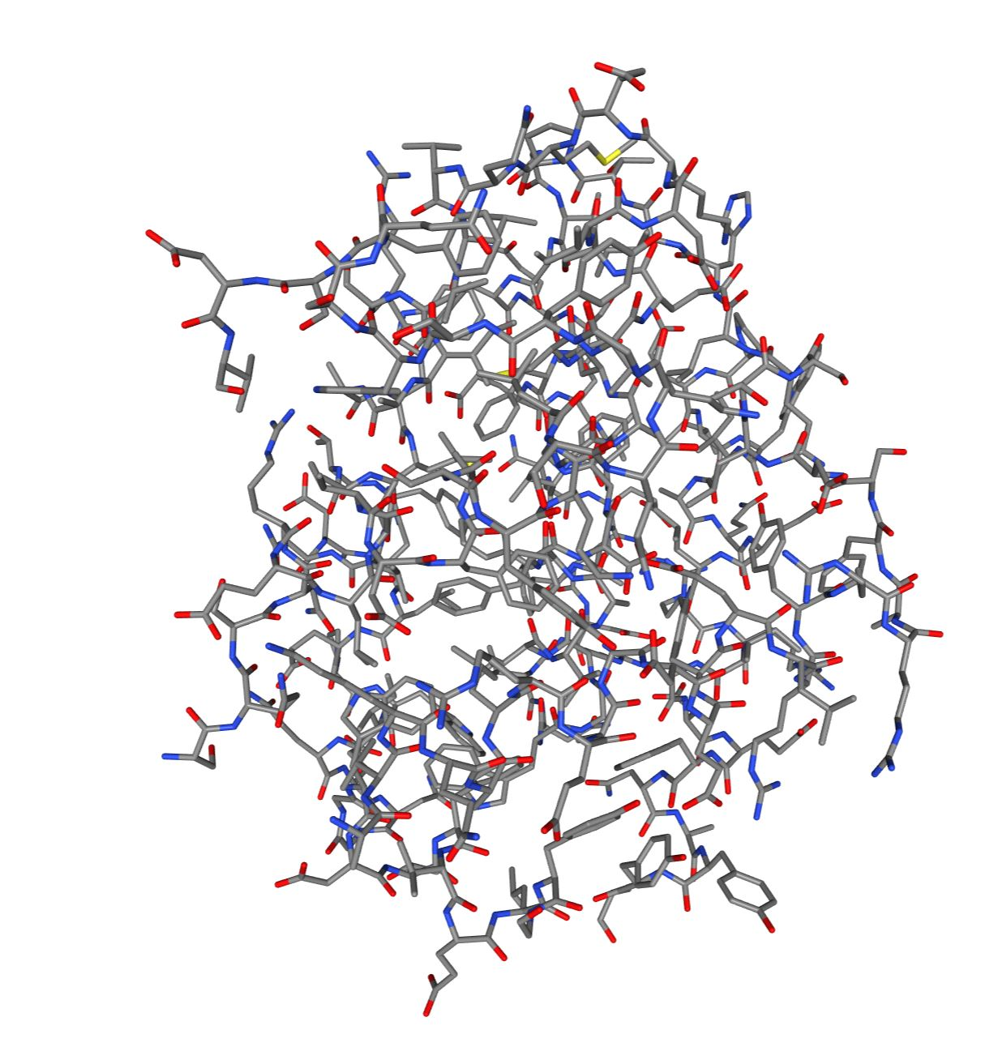
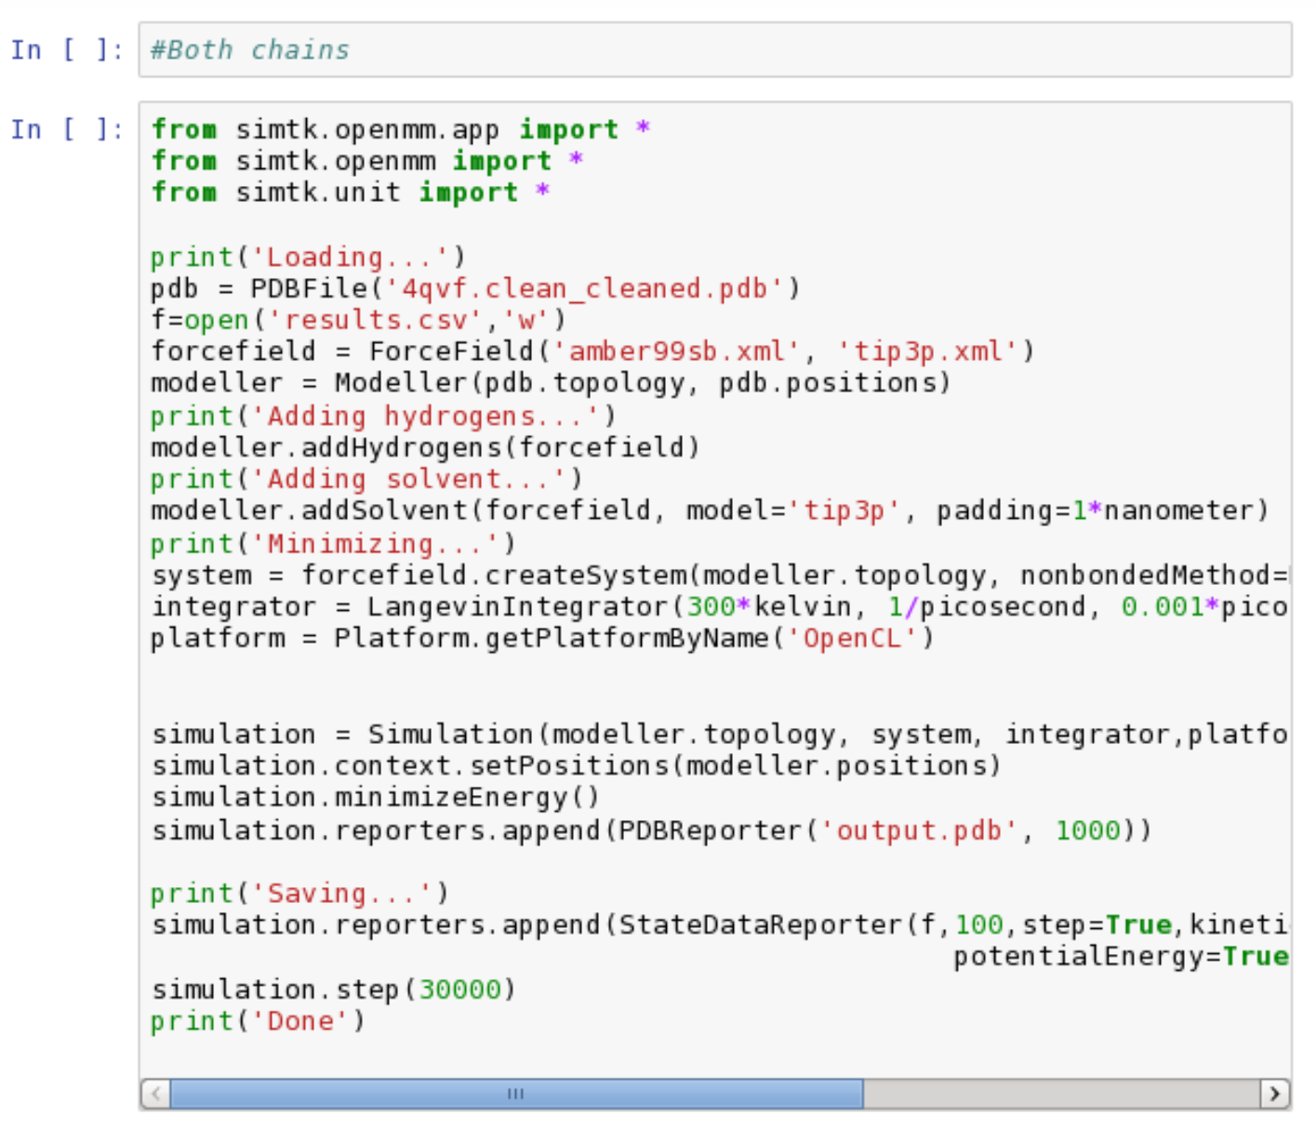
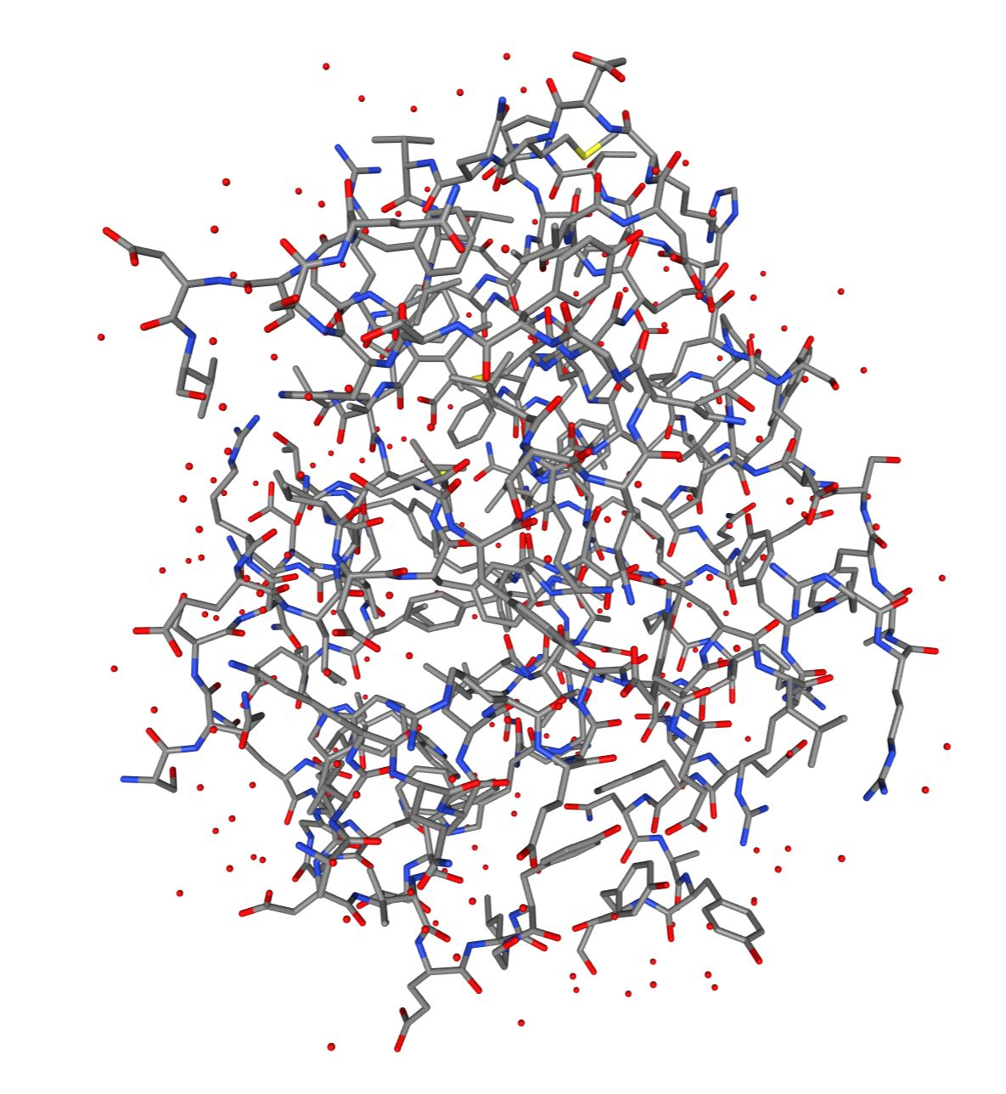
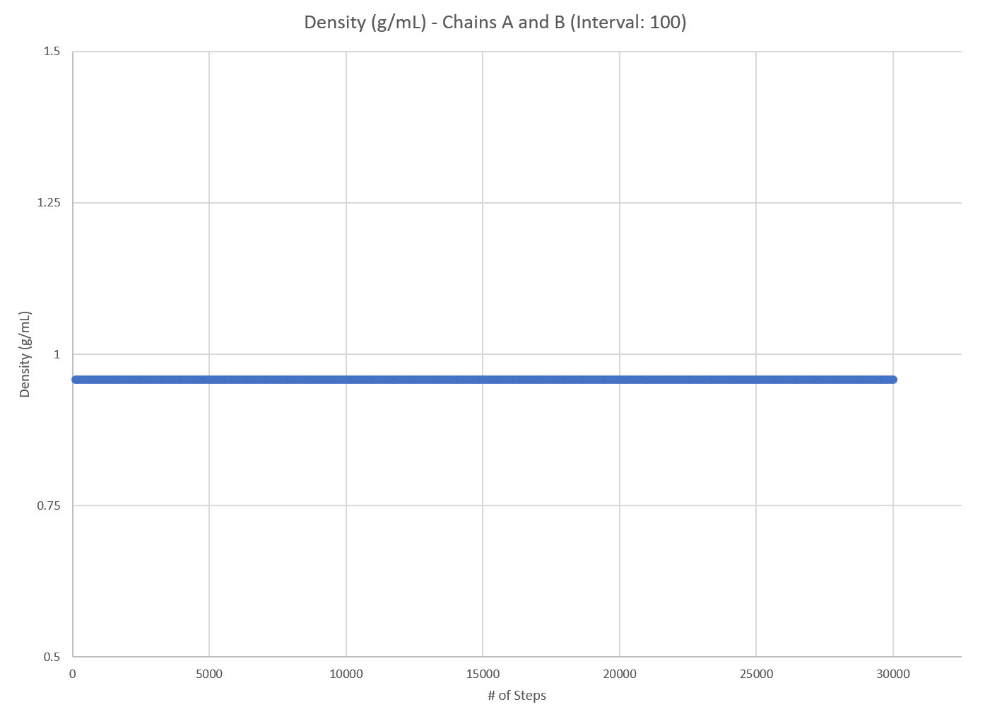
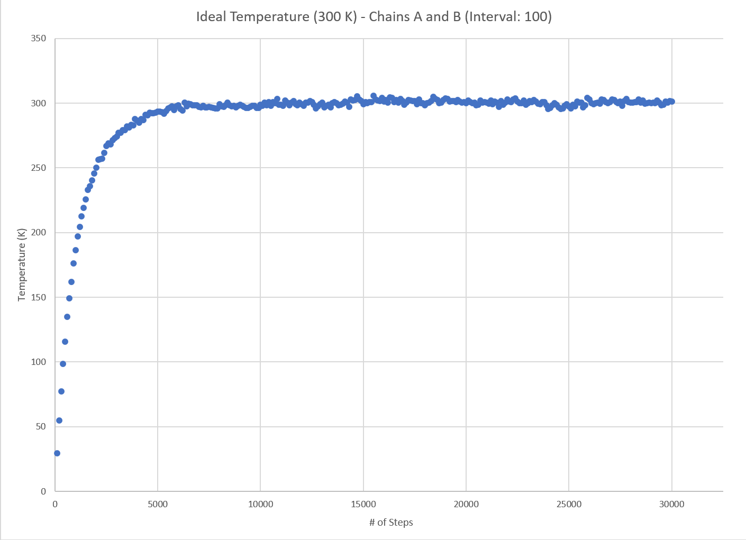
Results (A and B)
All energies reach equilibrium around step 6500
Estimated Equilibrium Total Energy for Chains A and B: -249613.87 kJ/mol

Slide 5
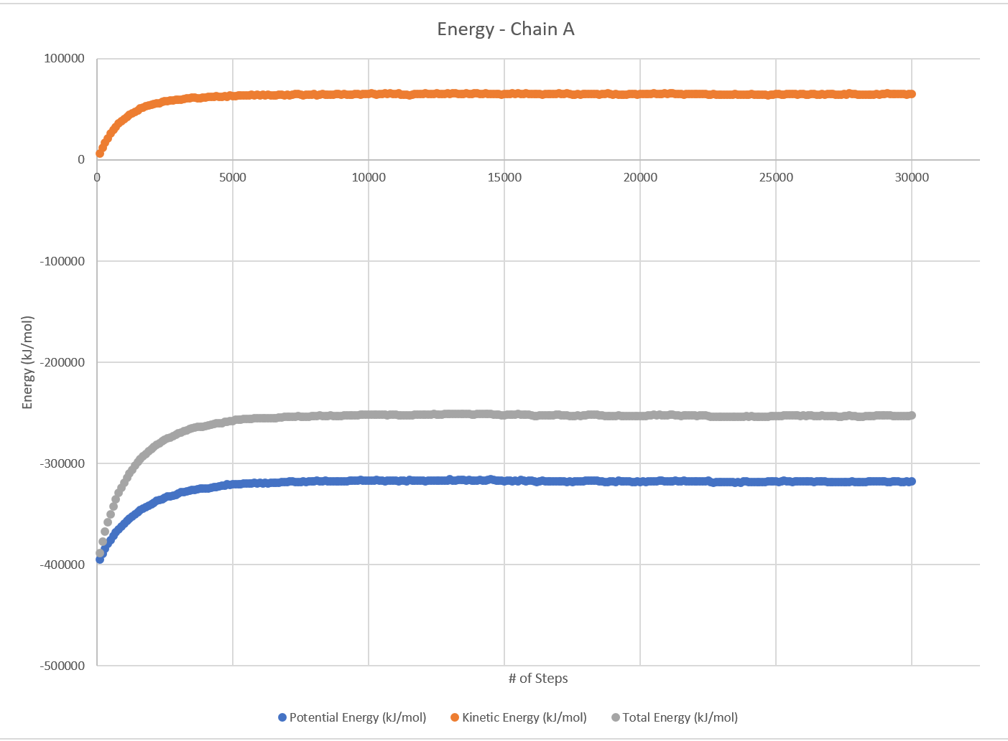
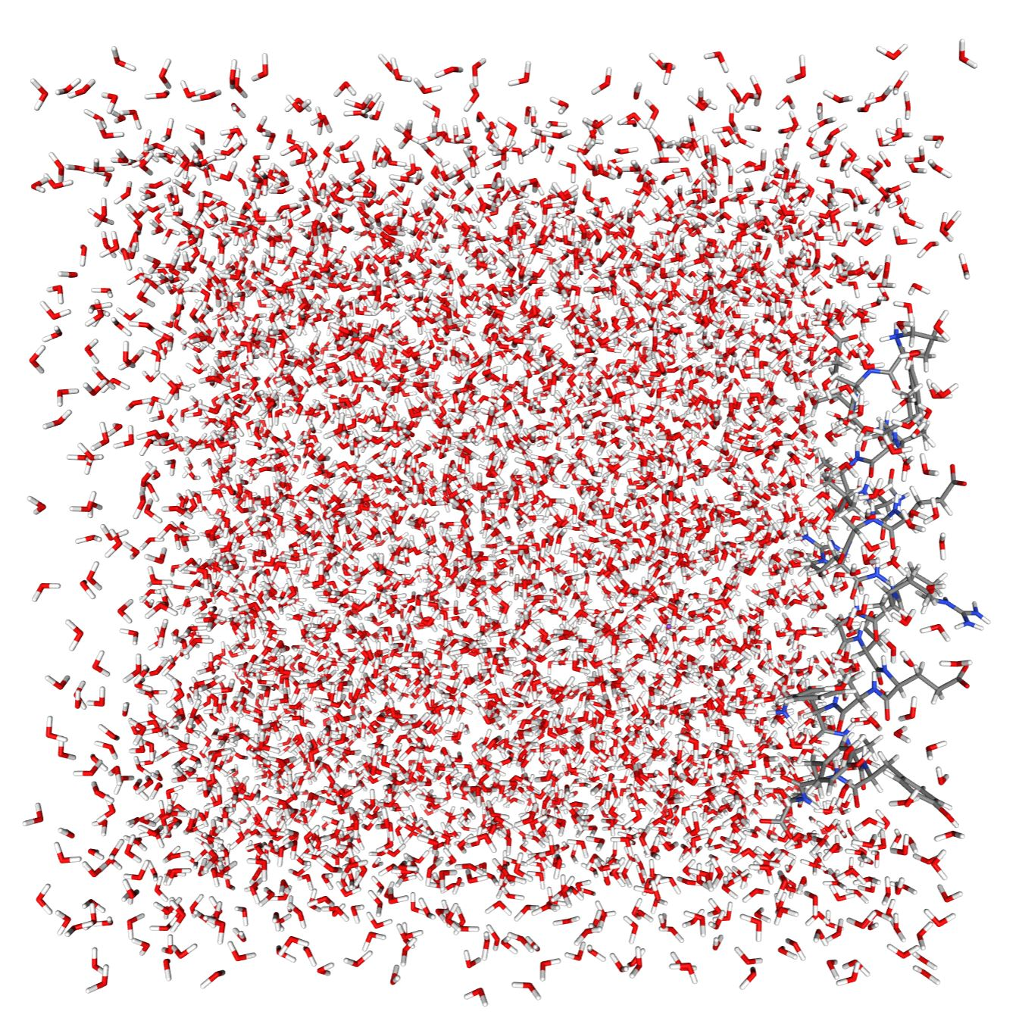
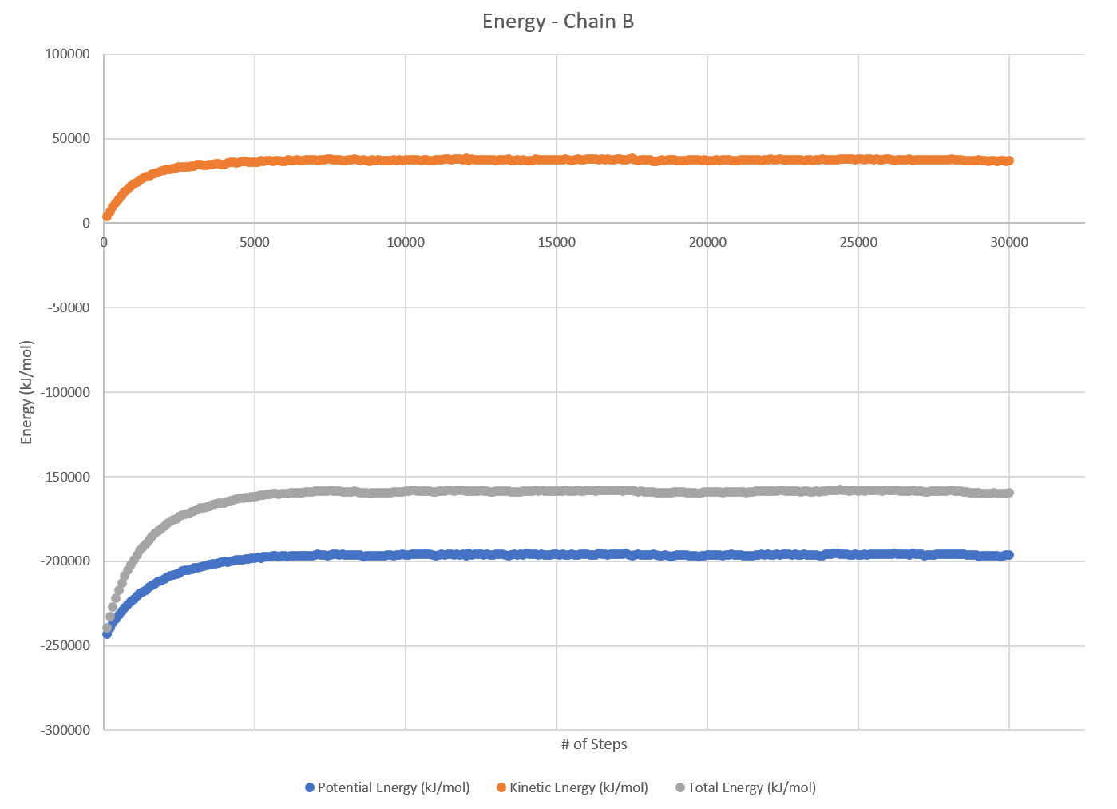
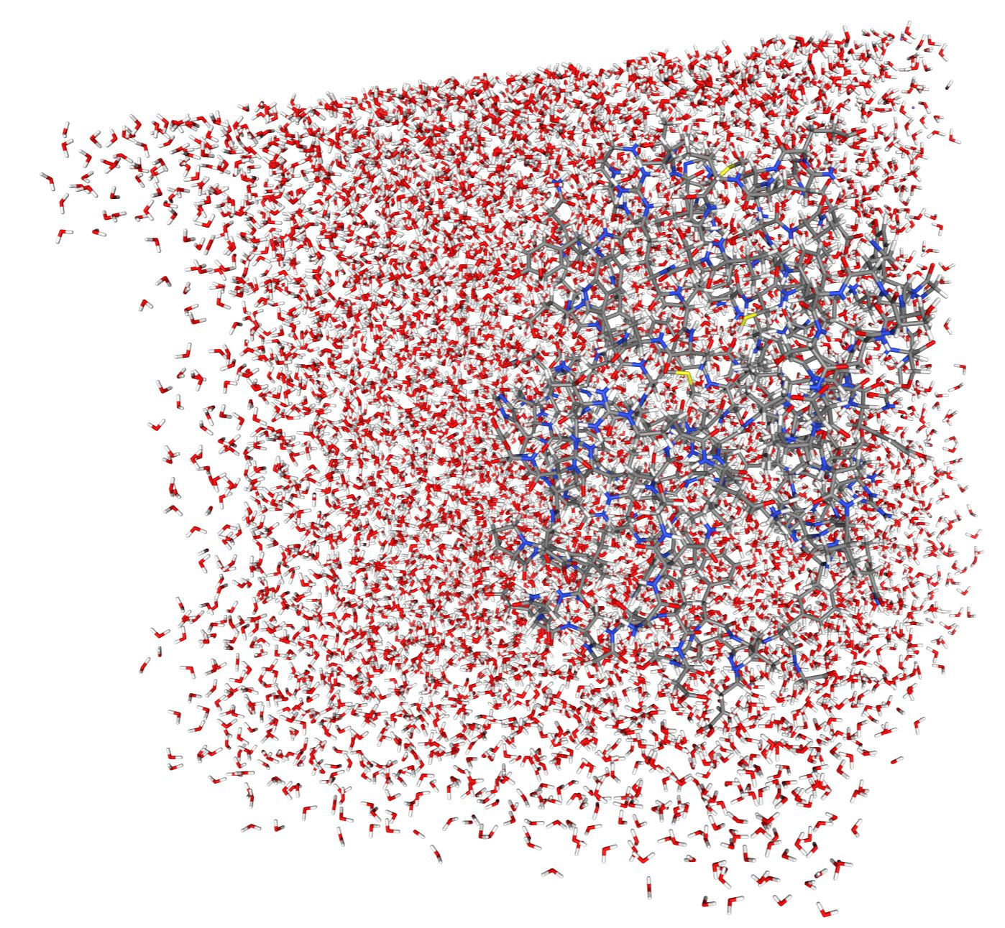
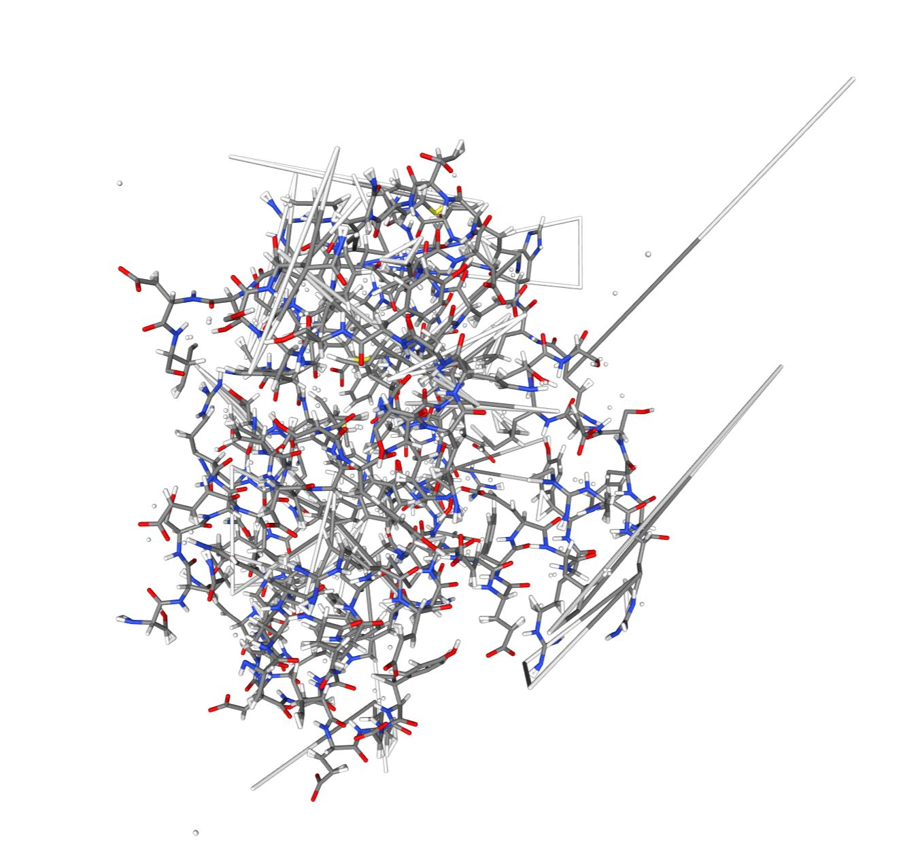
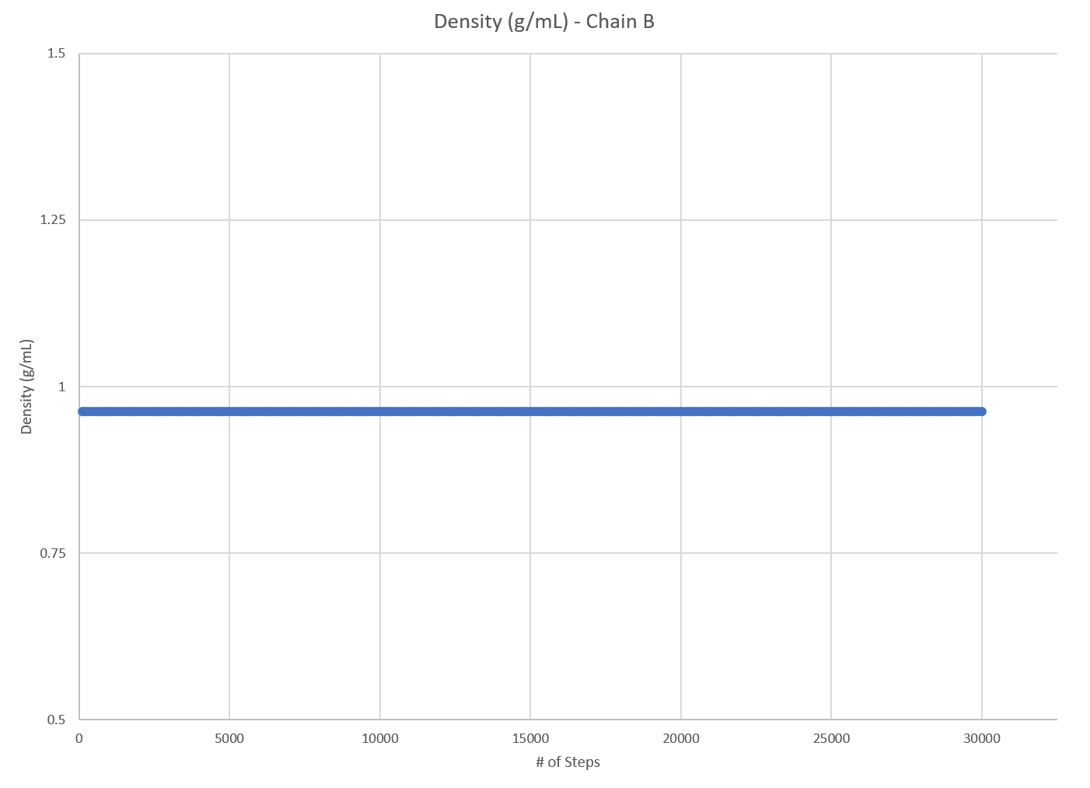
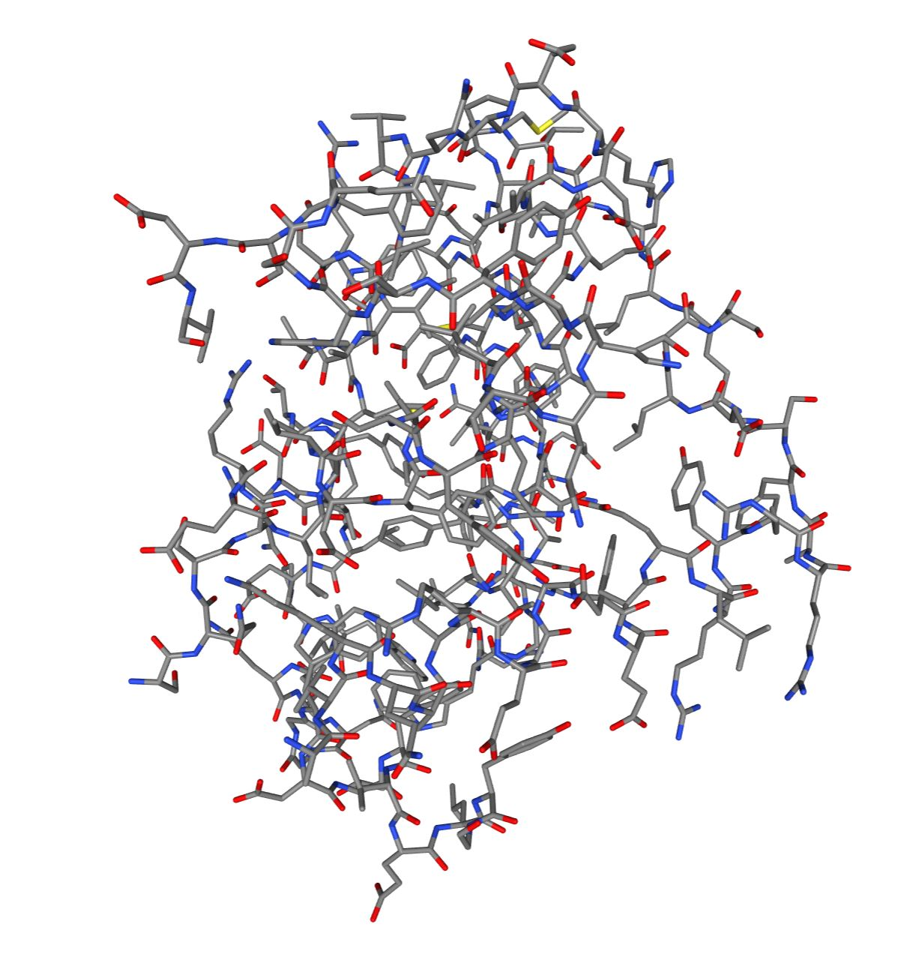
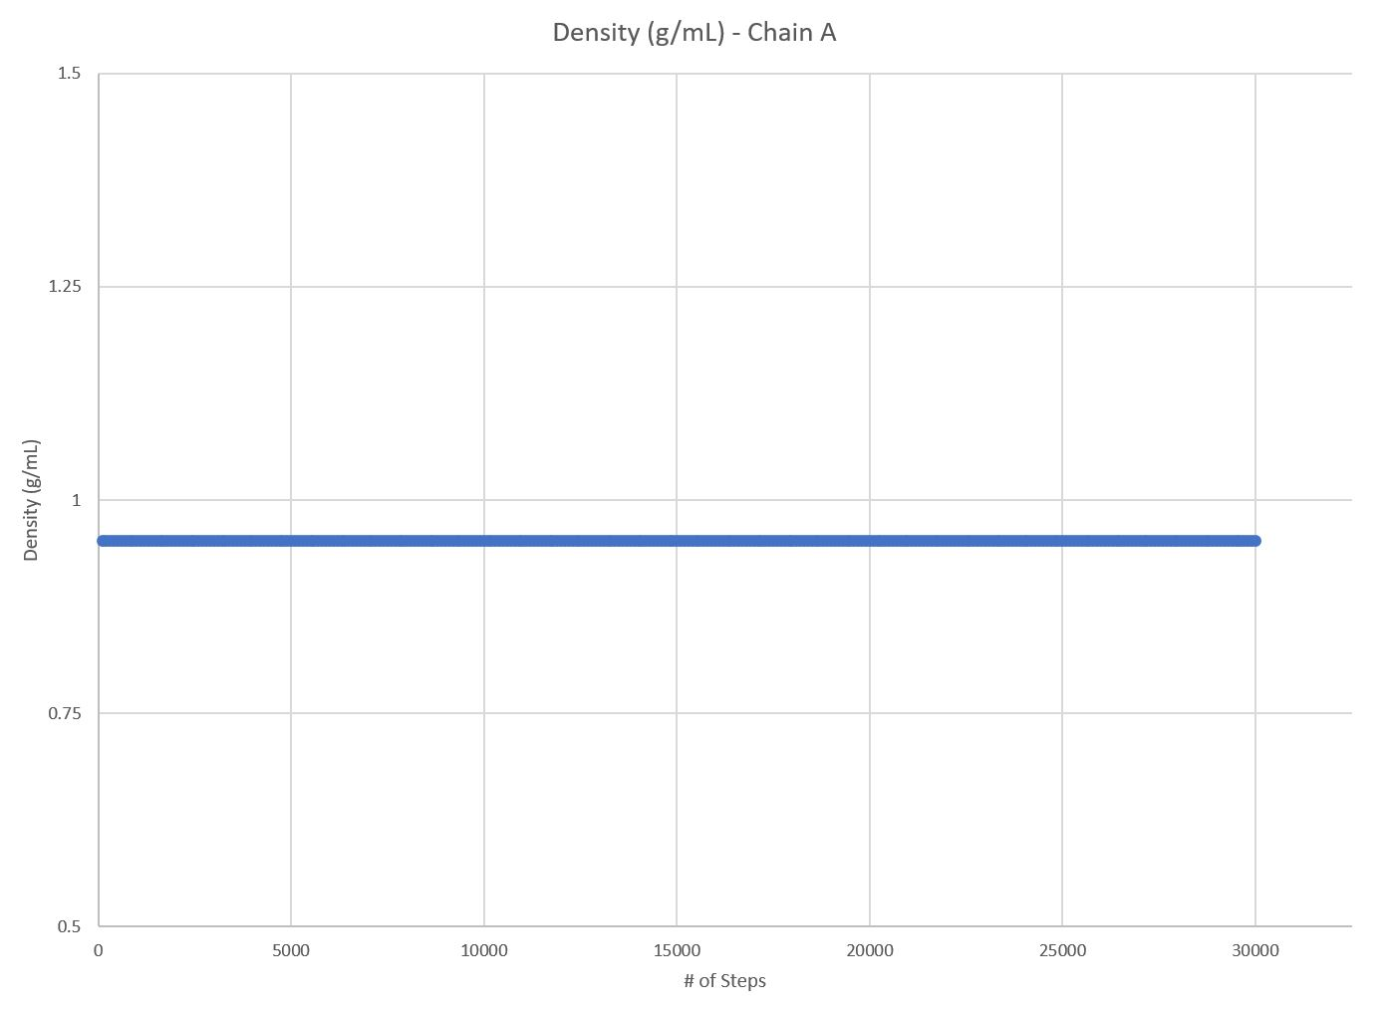
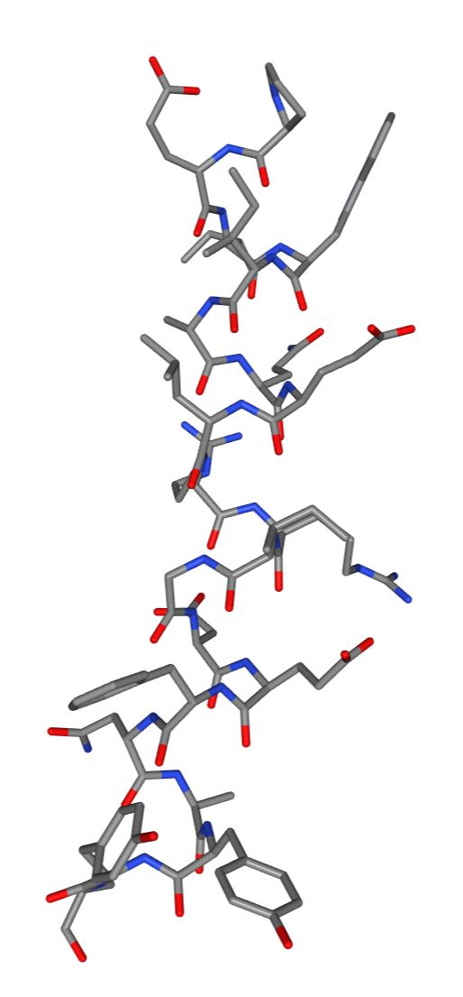
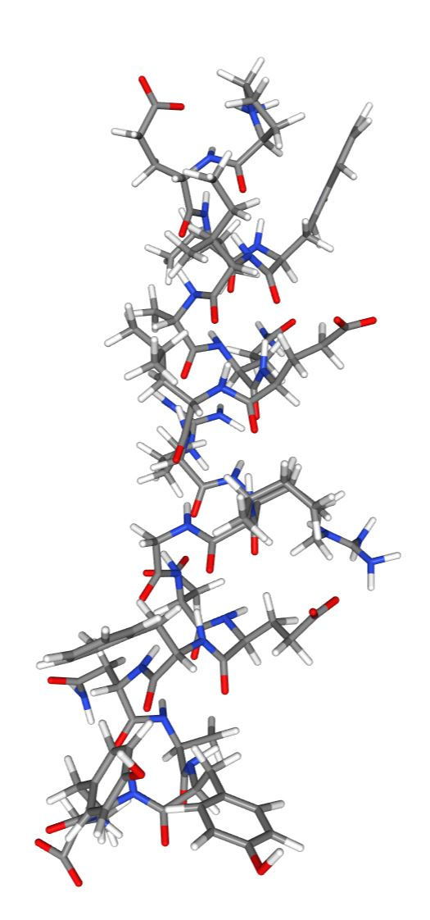
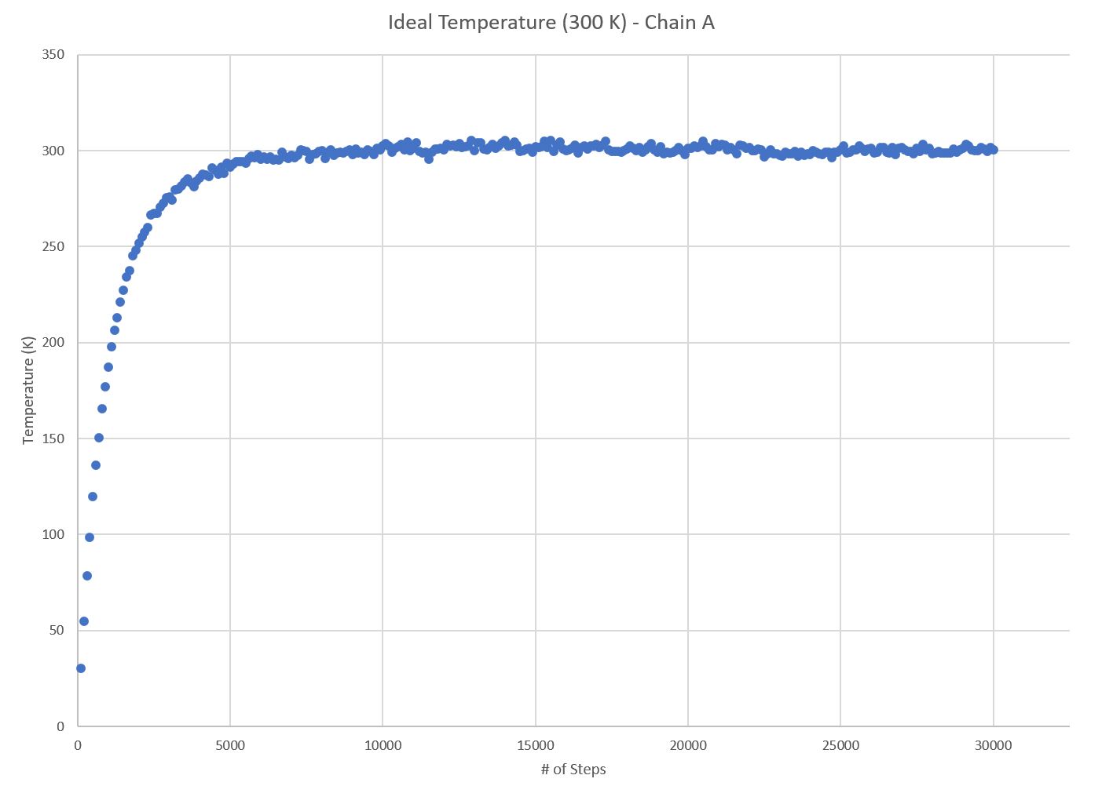
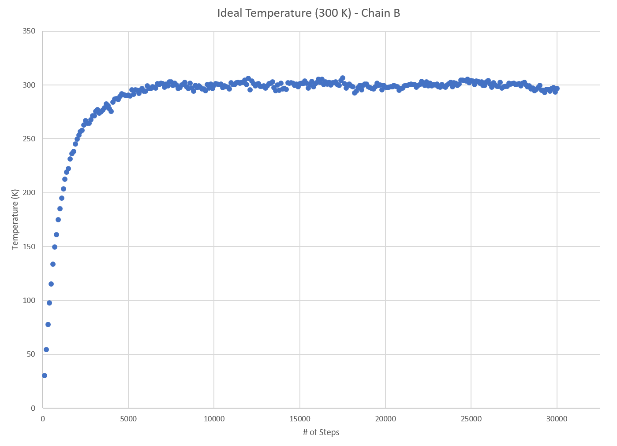
Chains and binding energy
Need to separate chains and run calculations and visualizations on each
Deleted other chain and saved into separate file
Chain A:
All energies reach equilibrium around step 6800
Estimated Equilibrium Total Energy for Chain A: -252546.27 kJ
Chain B:
All energies reach equilibrium around step 7000
Estimated Equilibrium Total Energy for Chain B: -158723.76 kJ
BE = Energy for (BCL-2) + Energy for (BIM-BH3) - Energy for complex (BCL-2-BIM-BH3)
-161656.16 = -252546.27 + -158723.76 - -249613.87
Binding Energy= -161656.16 kJ

Slide 6
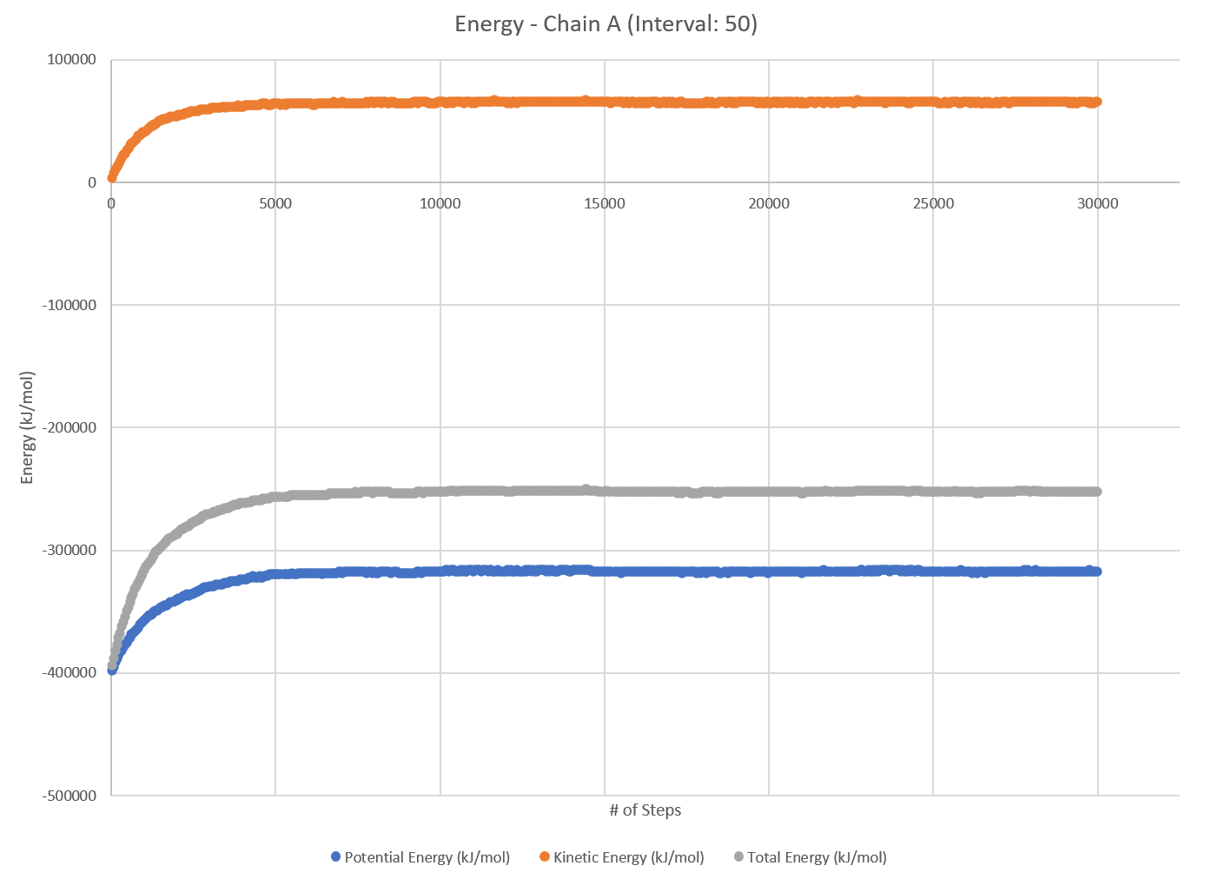
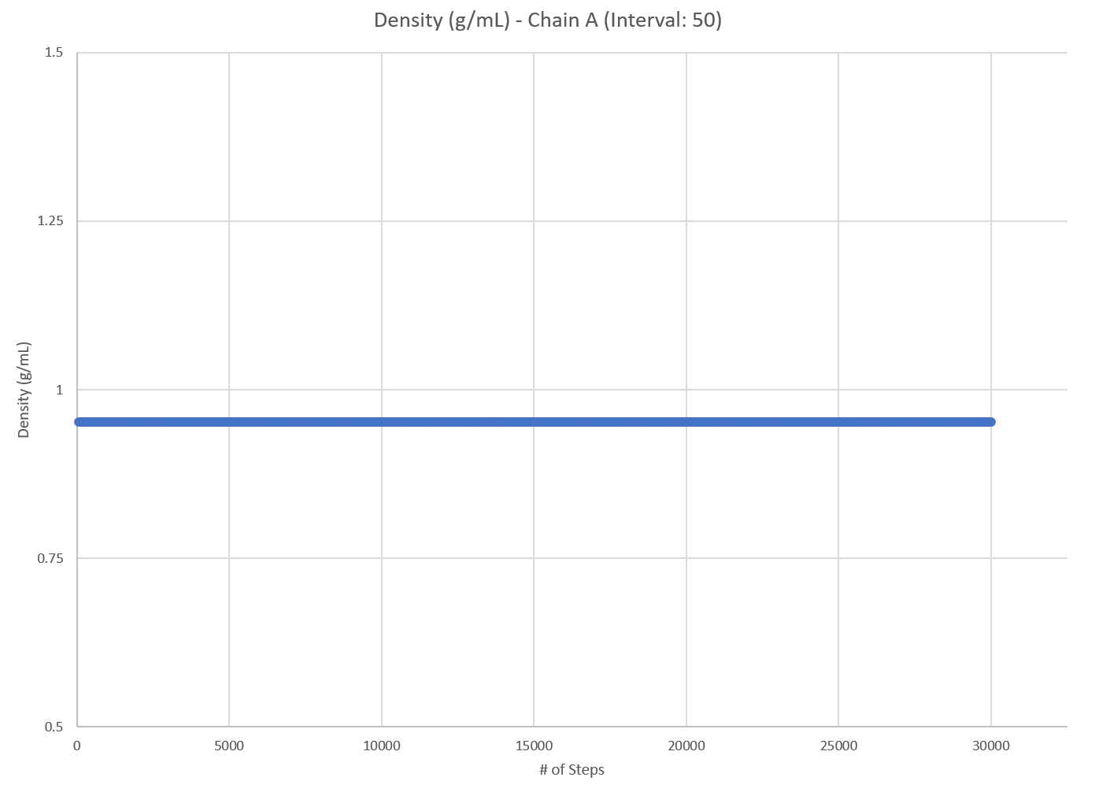
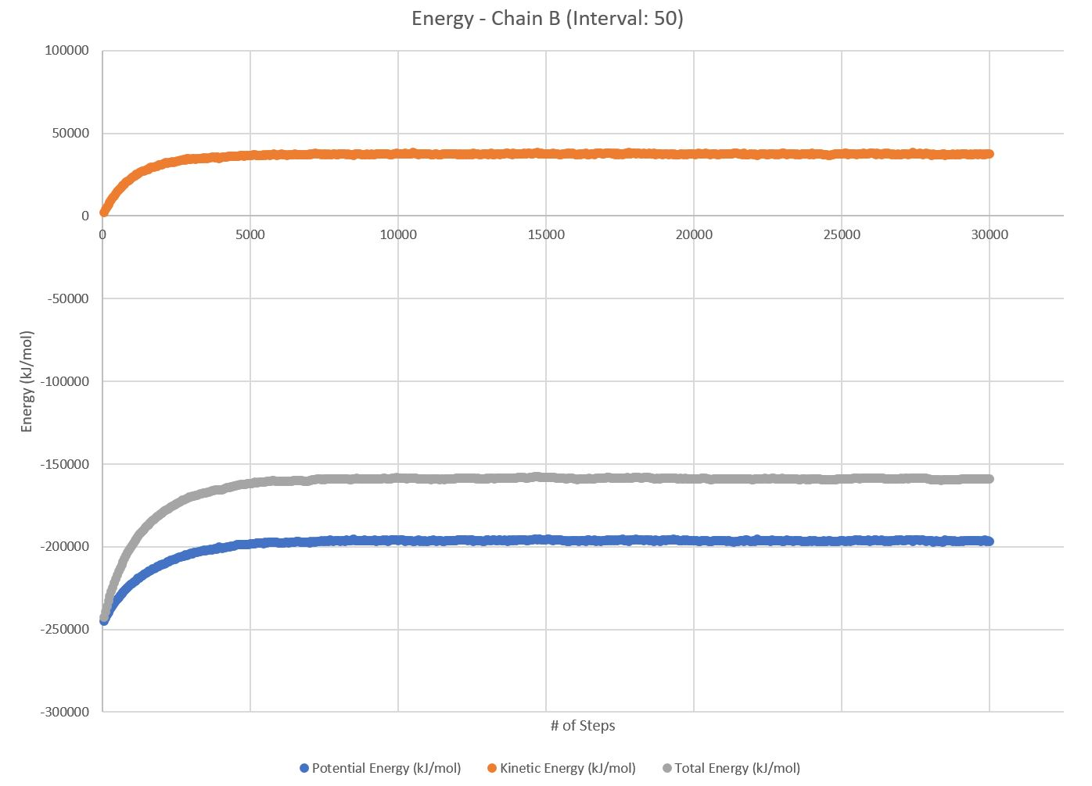
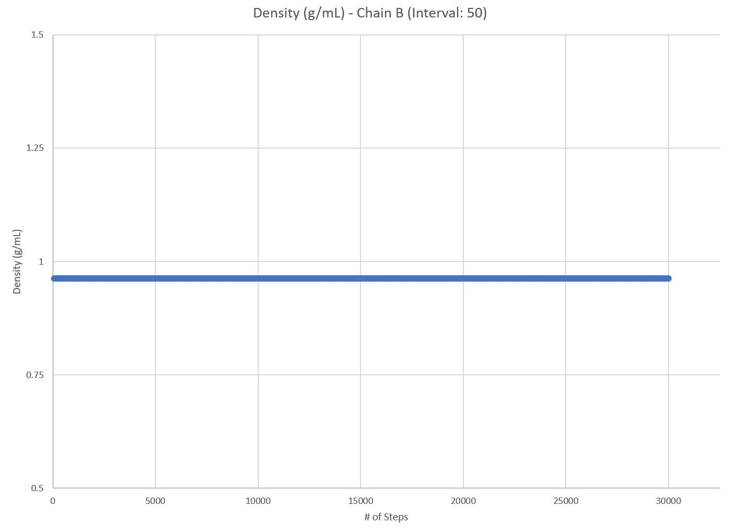
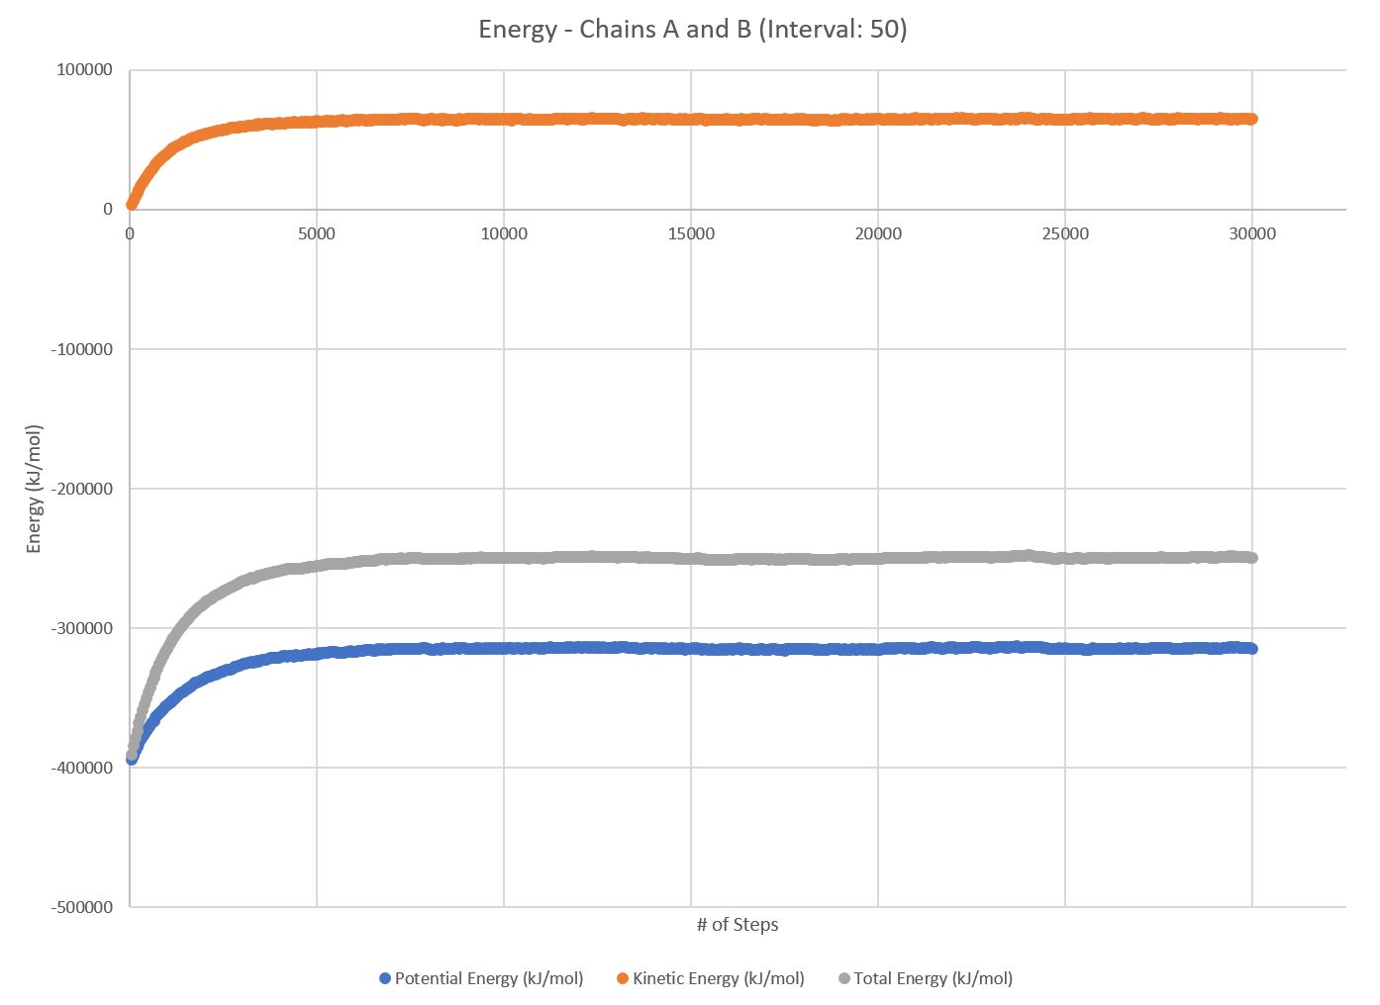

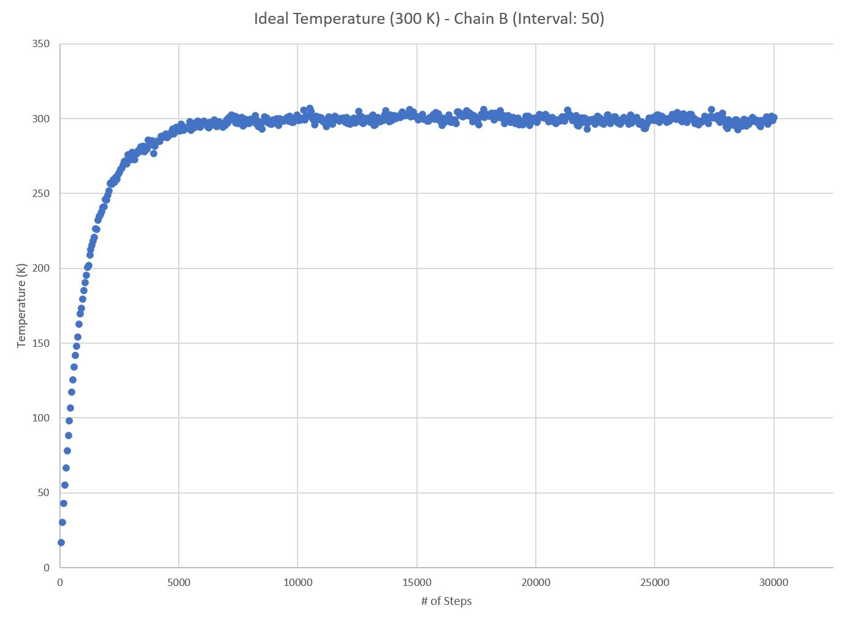
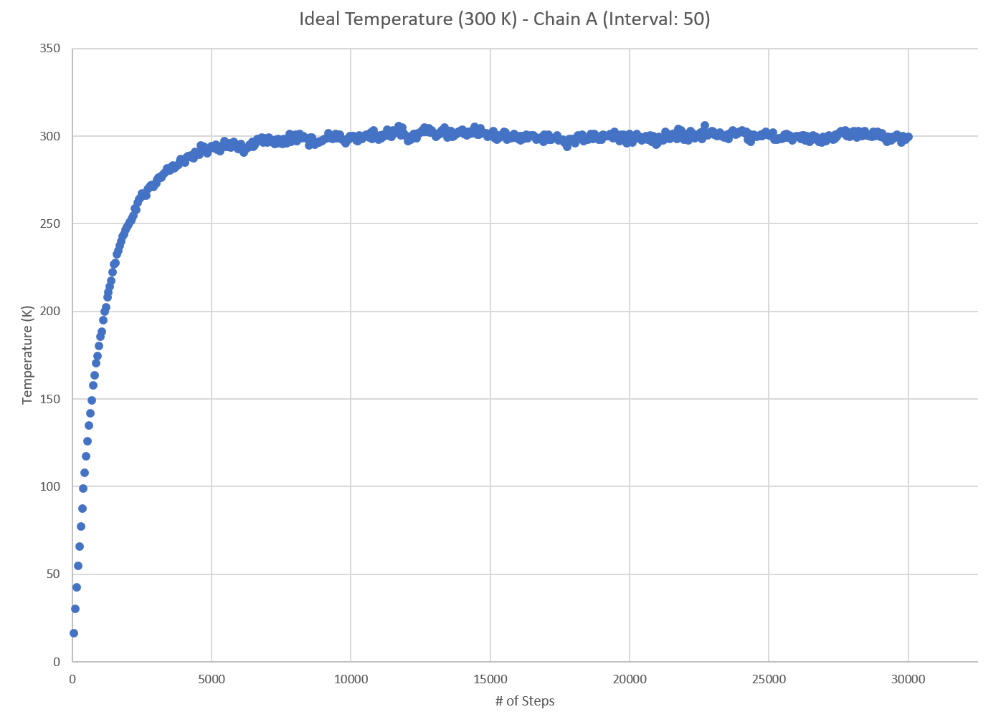
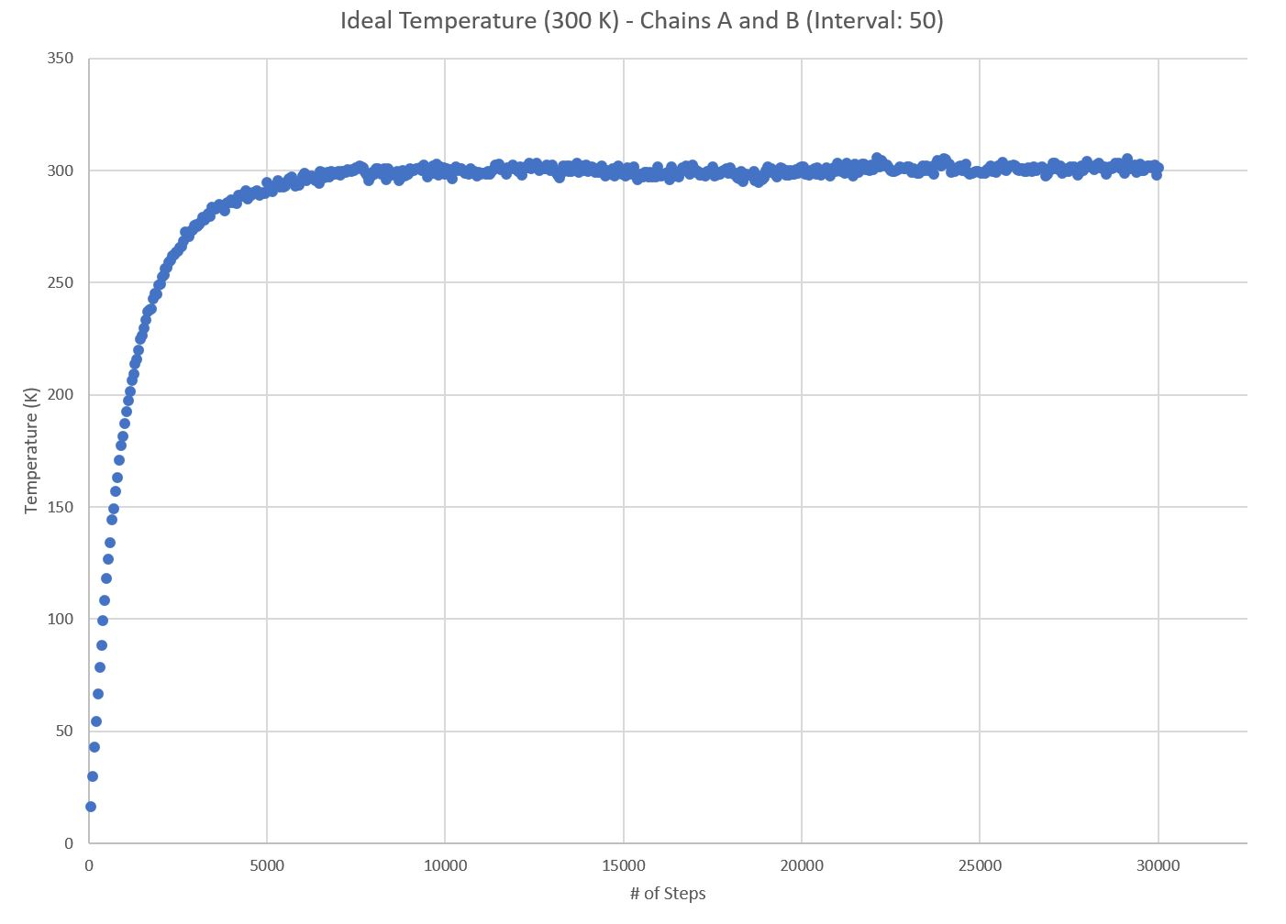
Test Case 1: Interval: 50
Chains A and B:
All energies reach equilibrium around step 7020
Estimated Equilibrium Total Energy for Chains A and B: -249609.40 kJ
Chain A:
All energies reach equilibrium around step 6450
Estimated Equilibrium Total Energy for Chain A: -252848.39 kJ
Chain B:
All energies reach equilibrium around step 7250
Estimated Equilibrium Total Energy for Chain B: -158836.60 kJ
BE = Energy for (BCL-2) + Energy for (BIM-BH3) - Energy for complex (BCL-2-BIM-BH3)
-162075.58 = -252848.39 + -158836.60 - -249609.40
Binding Energy= -162075.58 kJ

Slide 7
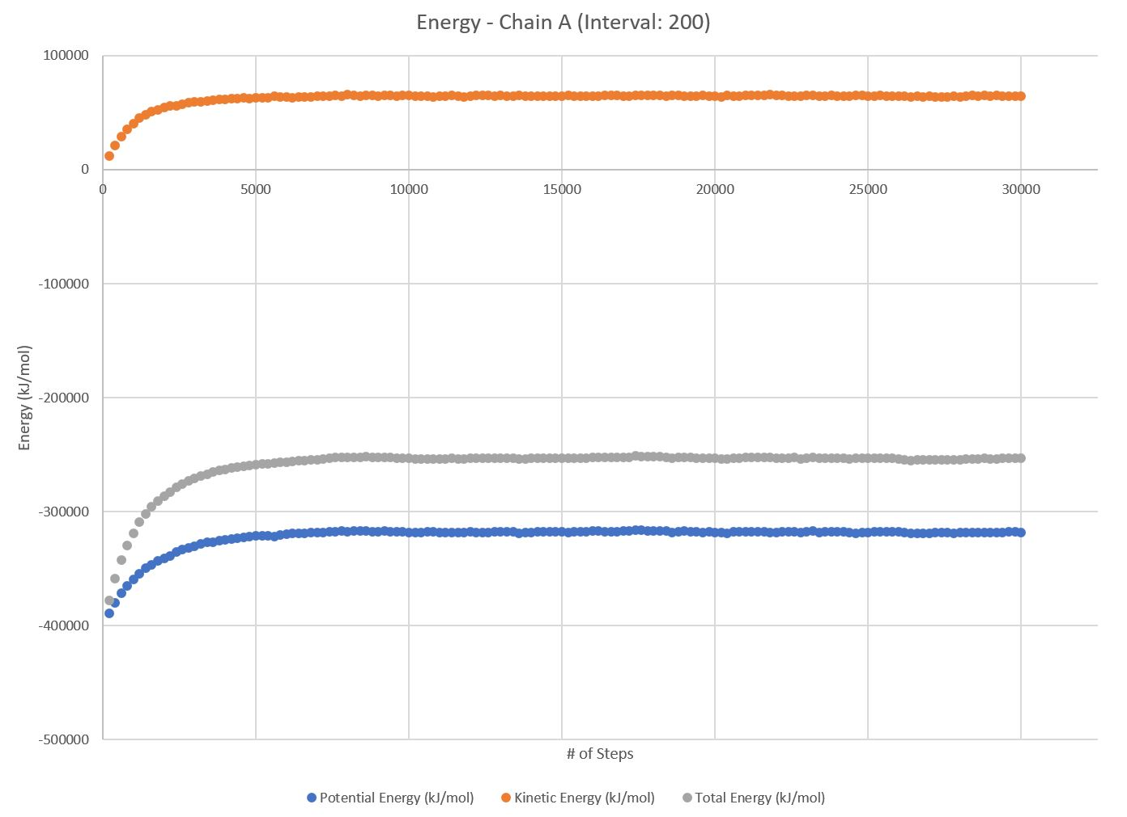
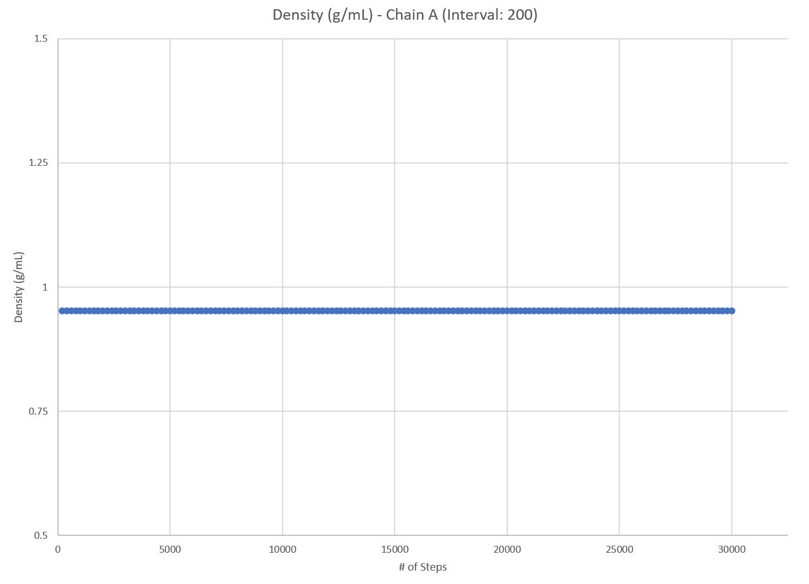
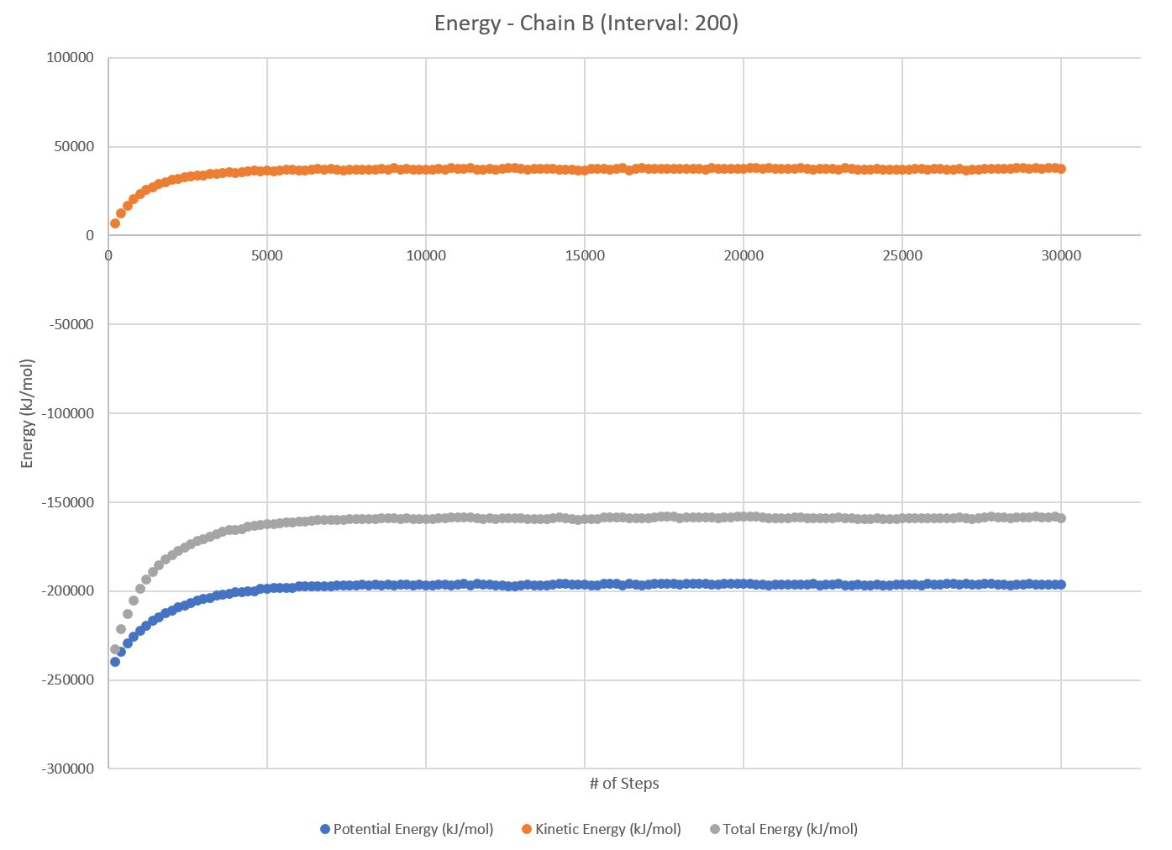

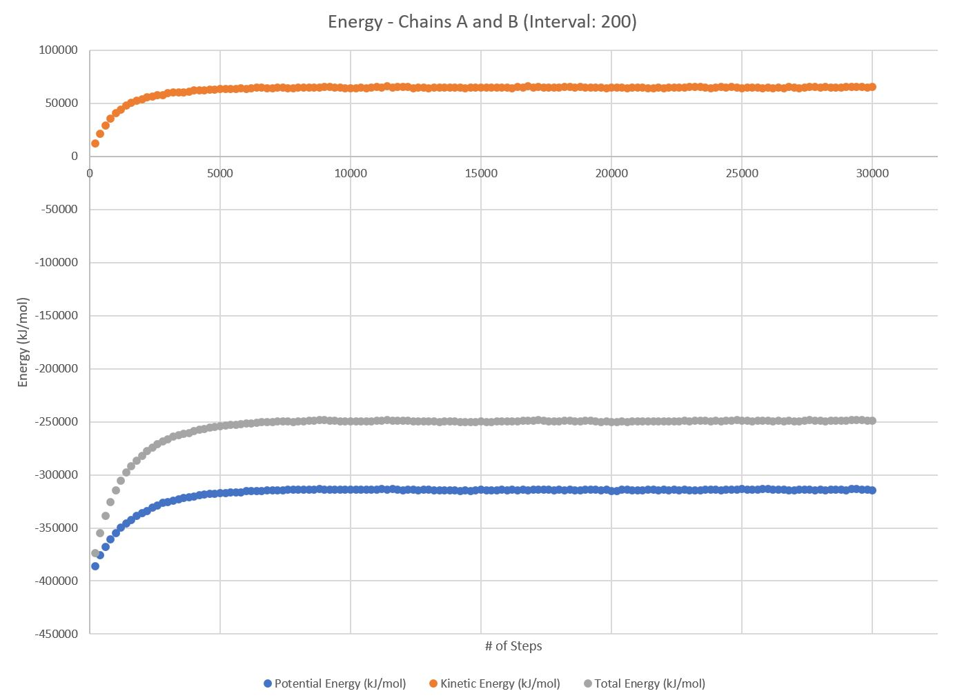
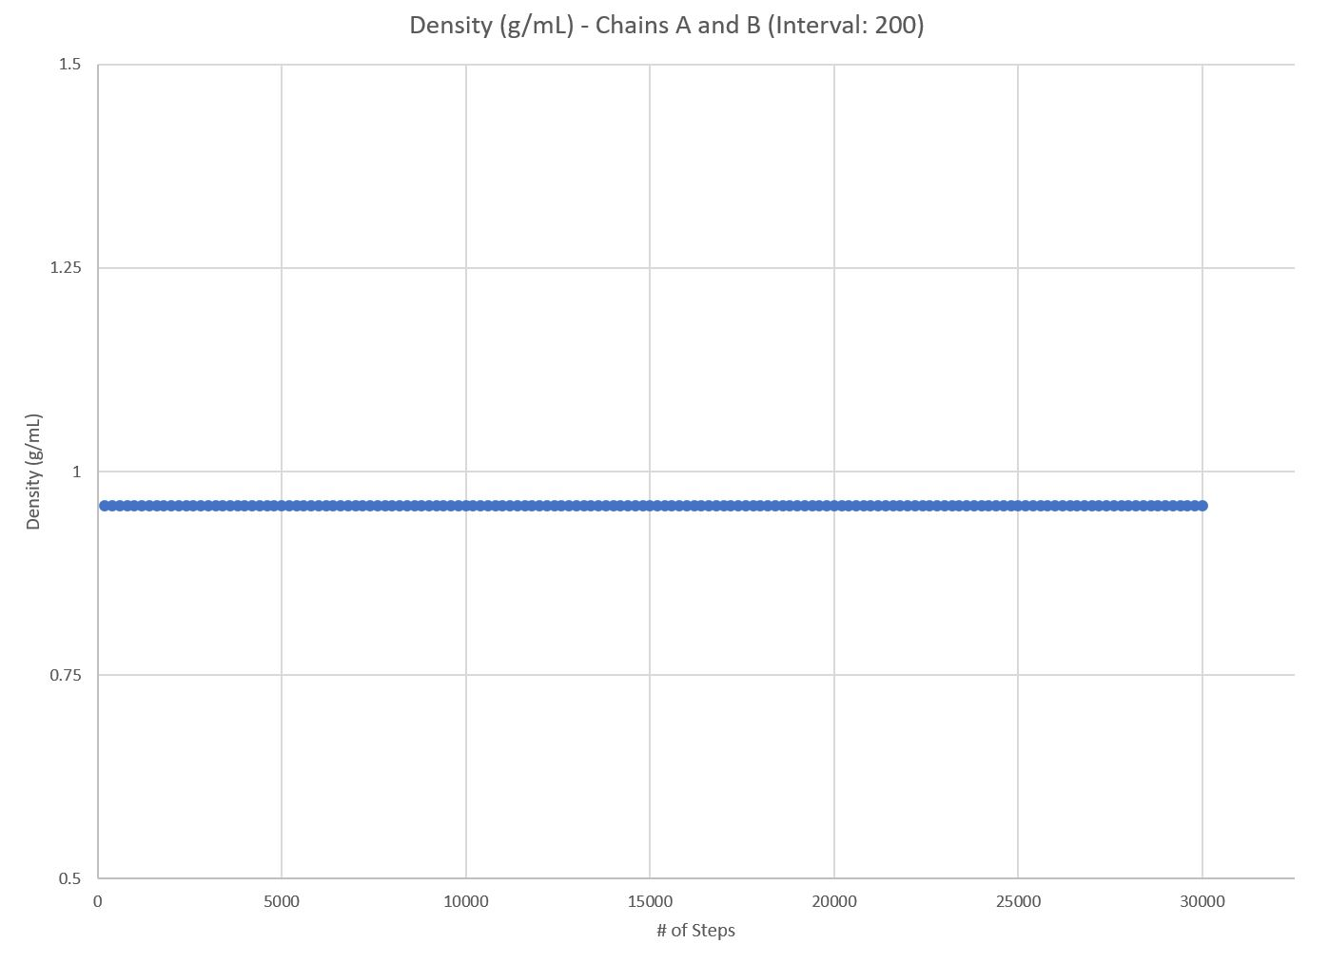
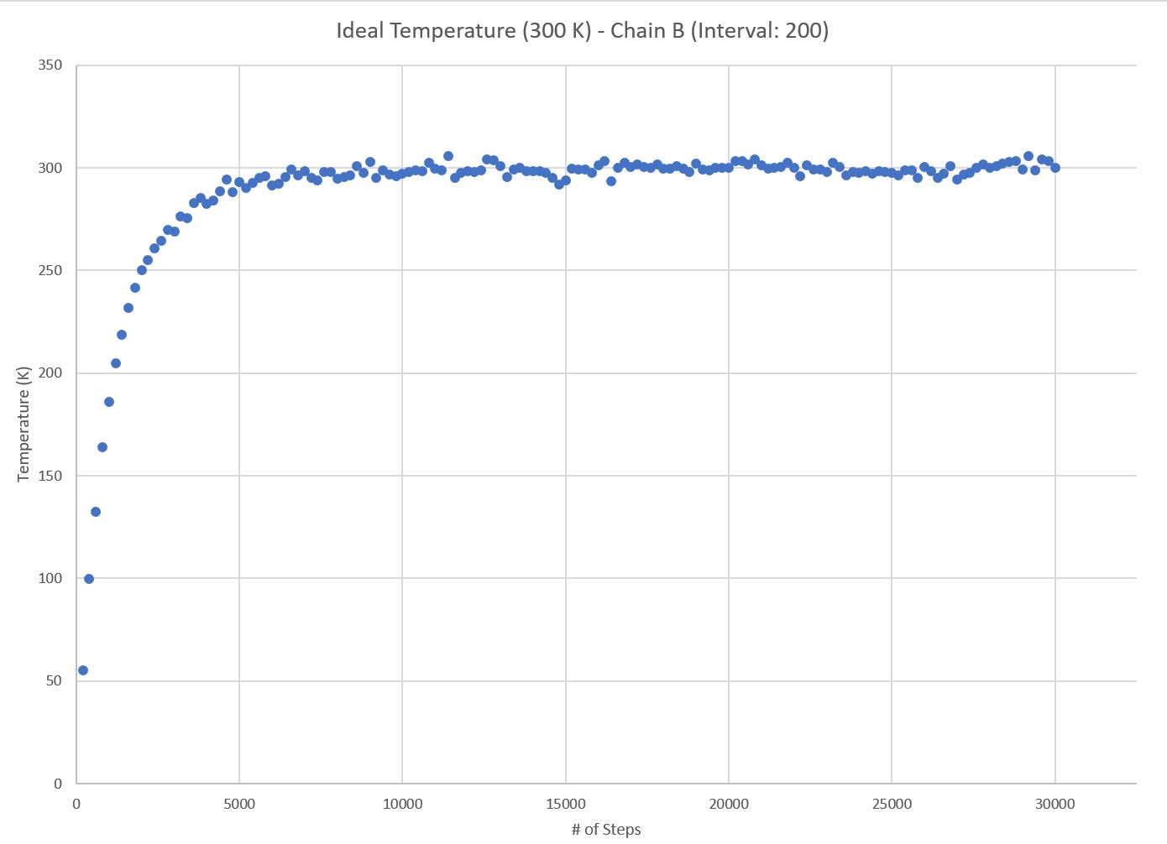
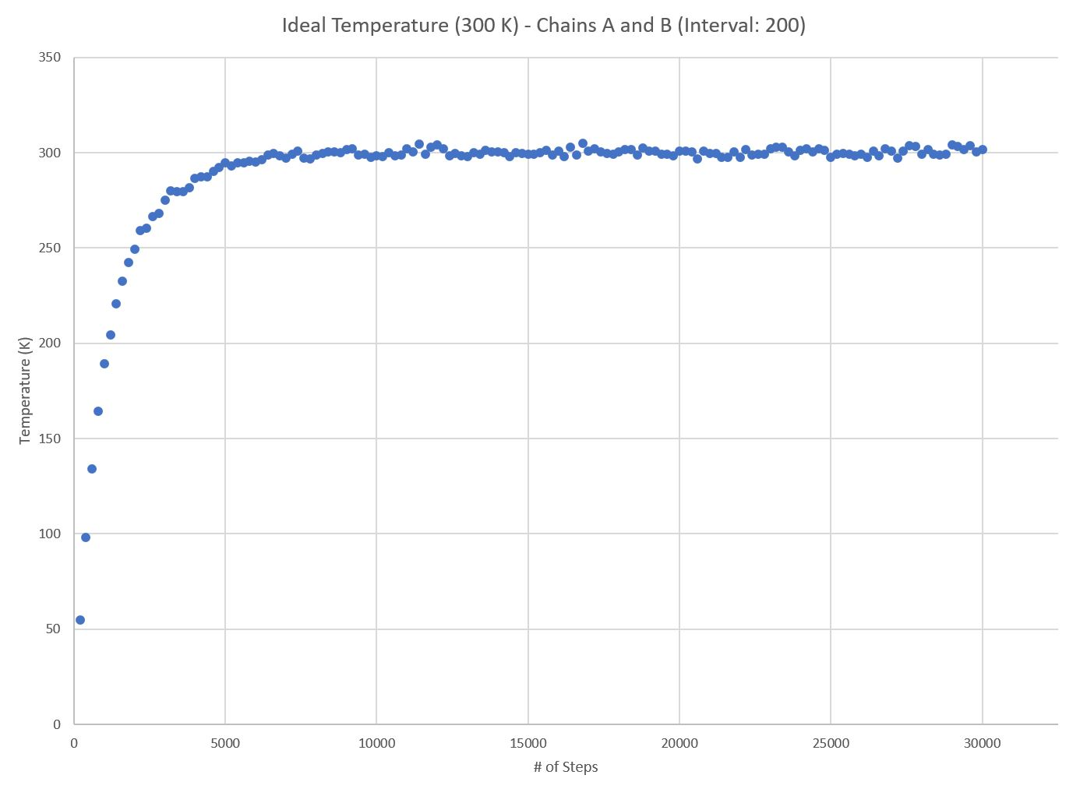
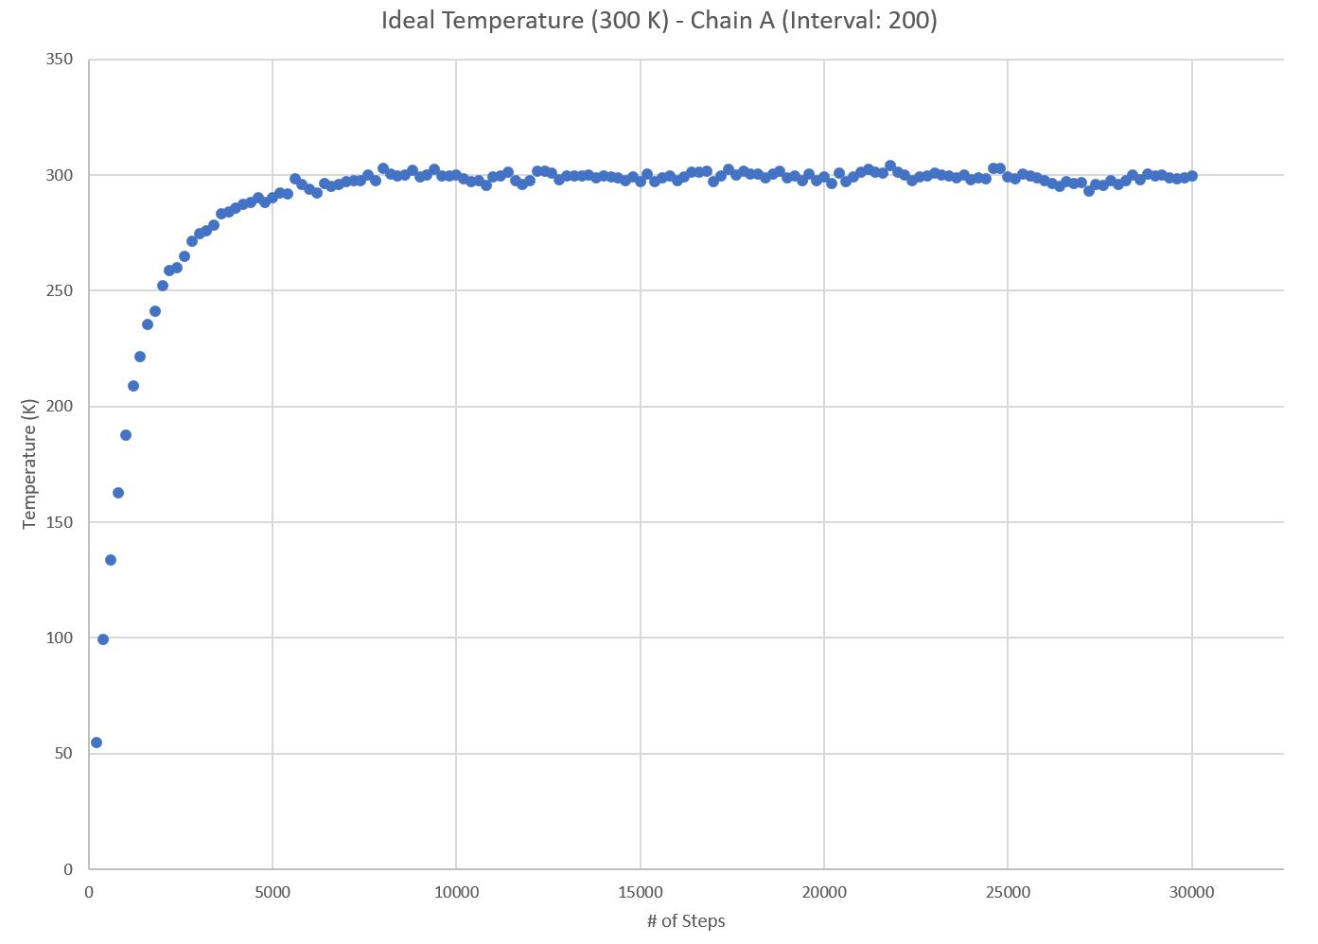
Test Case 2: Interval: 200
Chains A and B:
All energies reach equilibrium around step 7200
Estimated Equilibrium Total Energy for Chains A and B: -249374.33 kJ
Chain A:
All energies reach equilibrium around step 7800
Estimated Equilibrium Total Energy for Chain A: -253134.53 kJ
Chain B:
All energies reach equilibrium around step 7200
Estimated Equilibrium Total Energy for Chain B: -158941.52 kJ
BE = Energy for (BCL-2) + Energy for (BIM-BH3) - Energy for complex (BCL-2-BIM-BH3)
-162701.72 = -253134.53 + -158941.52 - -249374.33
Binding Energy= -162701.72 kJ

Slide 8
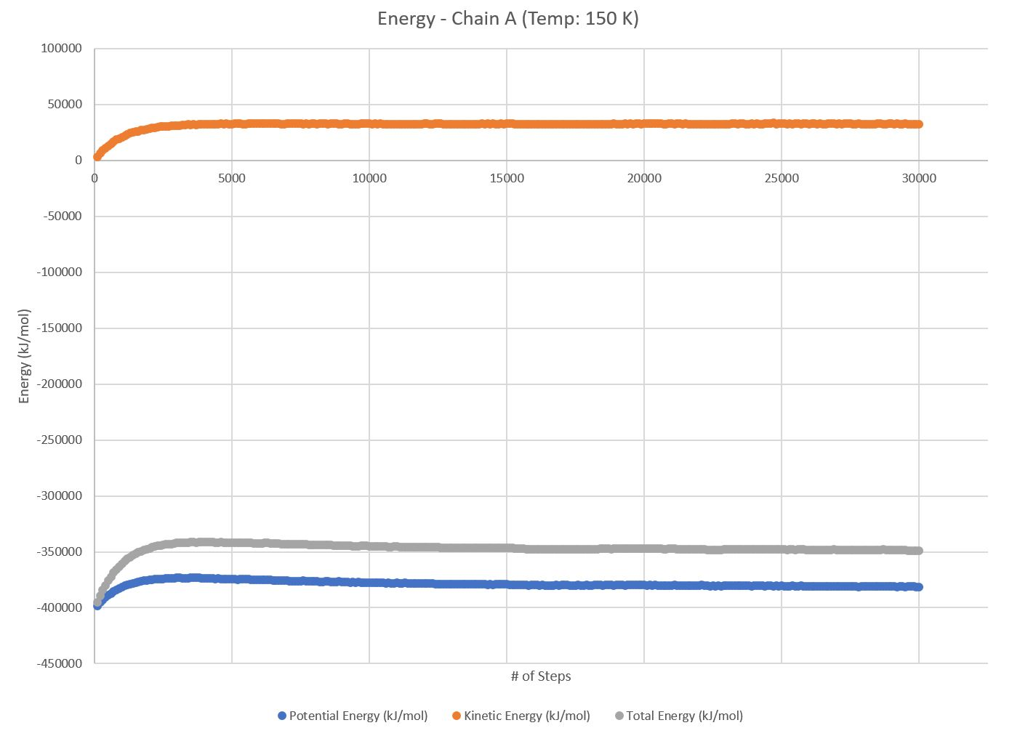

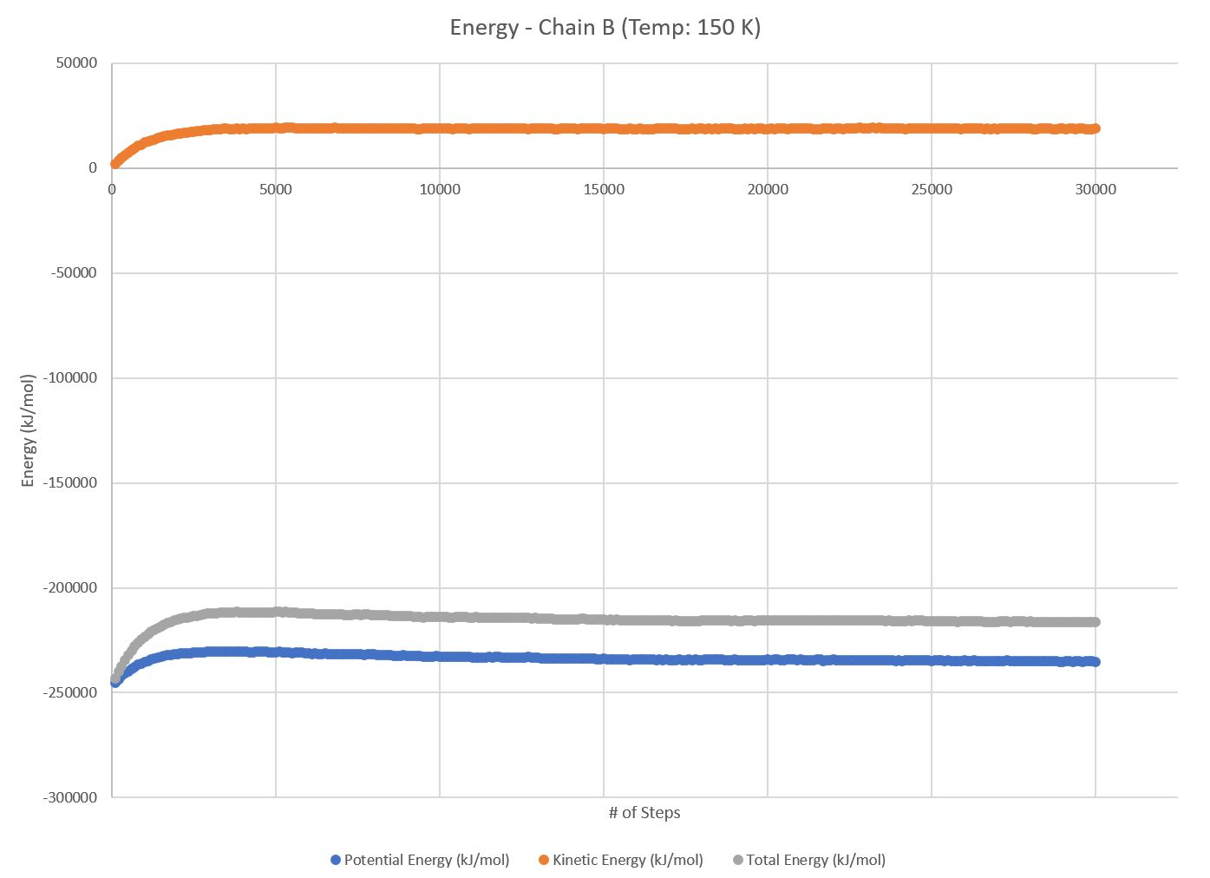

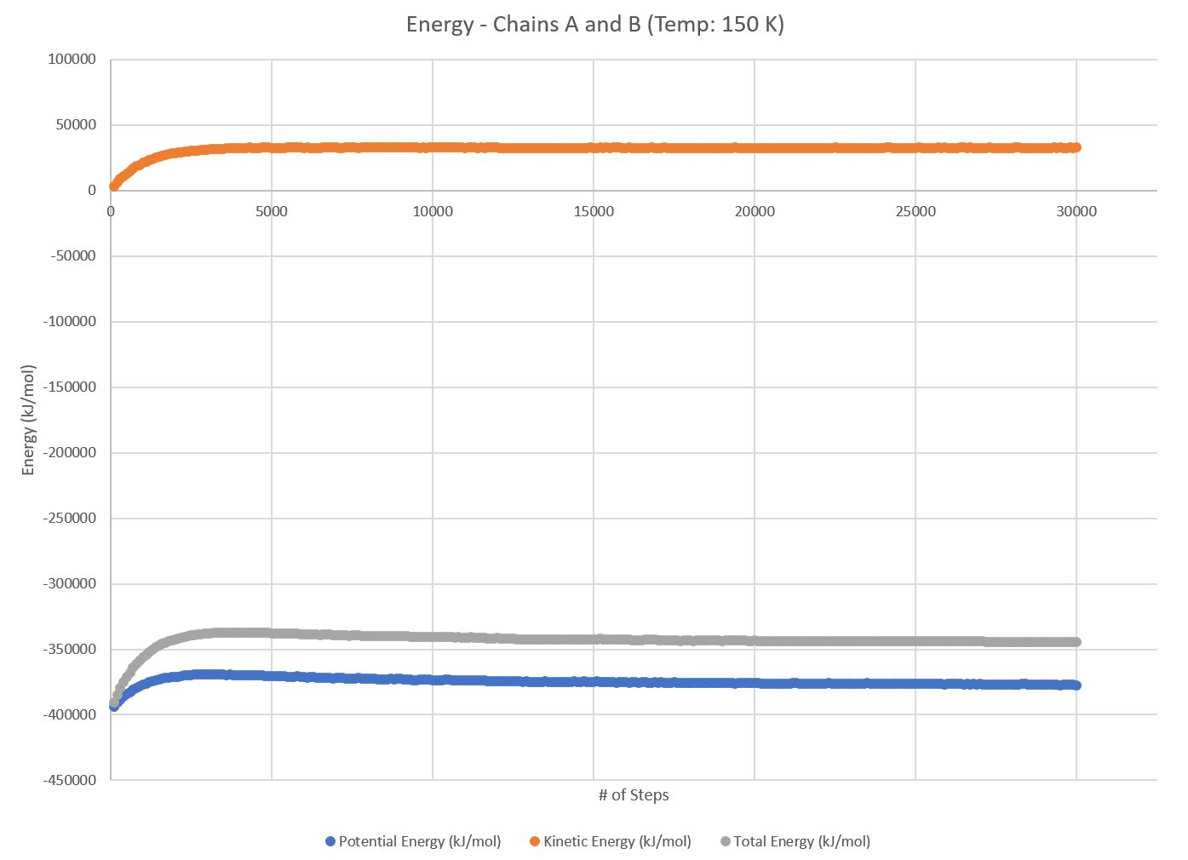
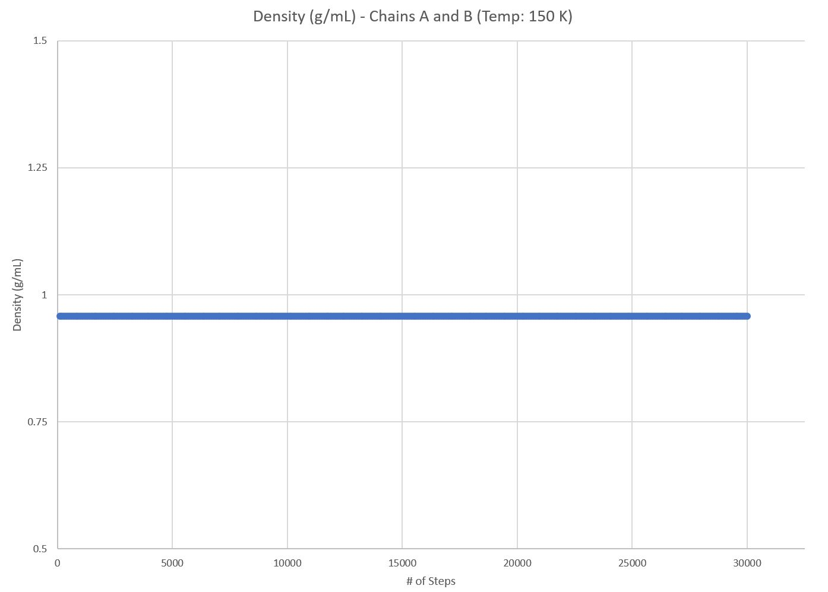
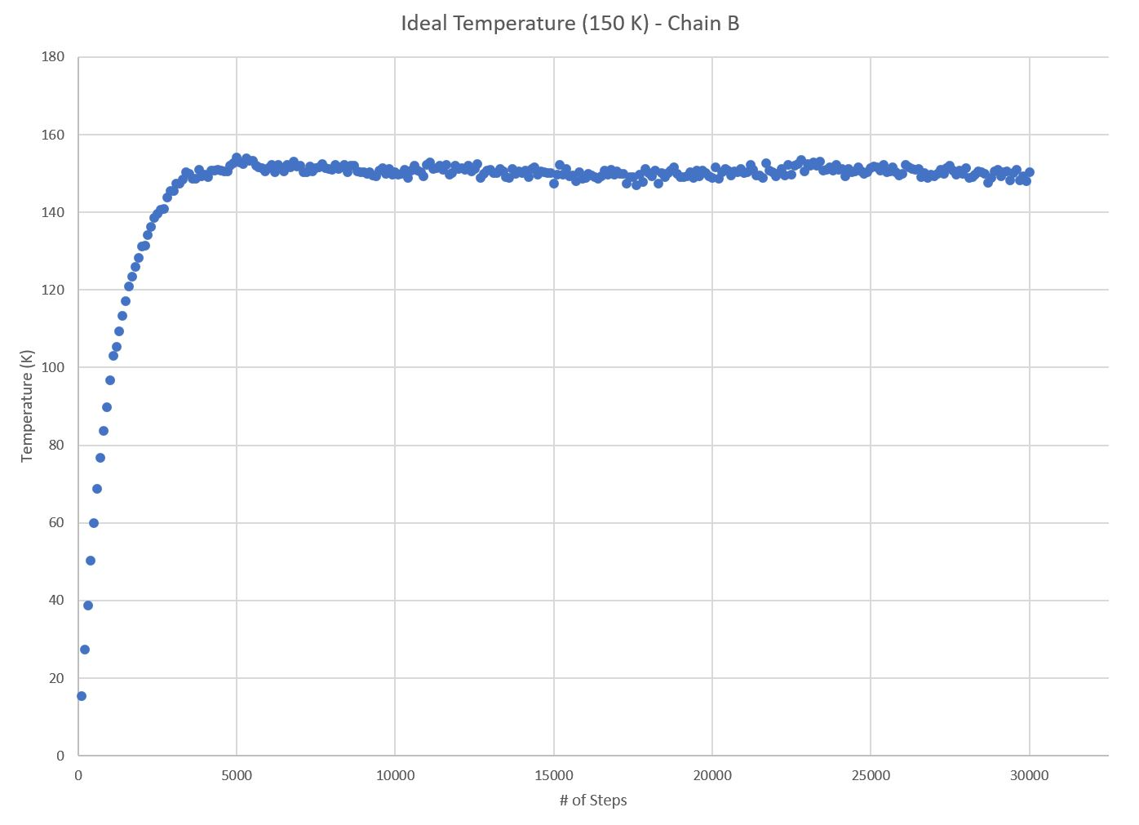
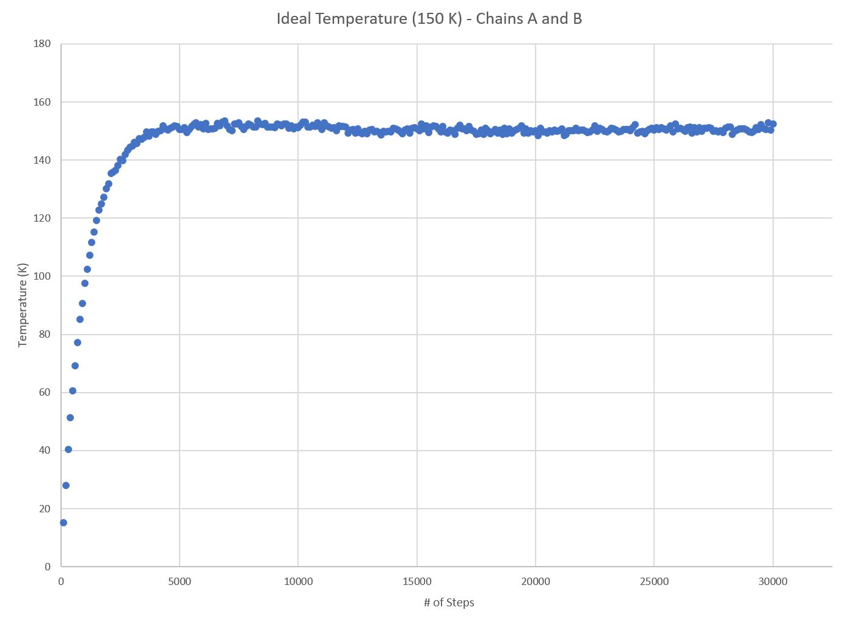
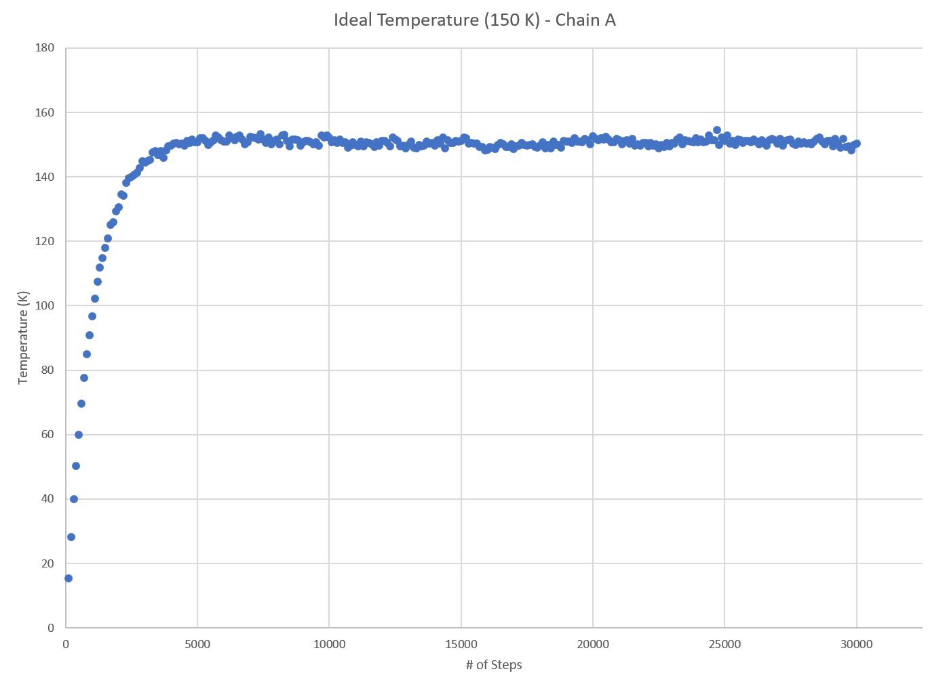
Test Case 3: TEMP: 150 K
Chains A and B:
All energies reach equilibrium around step 12800
Estimated Equilibrium Total Energy for Chains A and B: -343534.65 kJ
Chain A:
All energies reach equilibrium around step 6800
Estimated Equilibrium Total Energy for Chain A: -347699.50 kJ
Chain B:
All energies reach equilibrium around step 17700
Estimated Equilibrium Total Energy for Chain B: -215821.59 kJ
BE = Energy for (BCL-2) + Energy for (BIM-BH3) - Energy for complex (BCL-2-BIM-BH3)
-219986.44 = -347699.50 + -215821.59 - -343534.65
Binding Energy= -219986.44 kJ

Slide 9
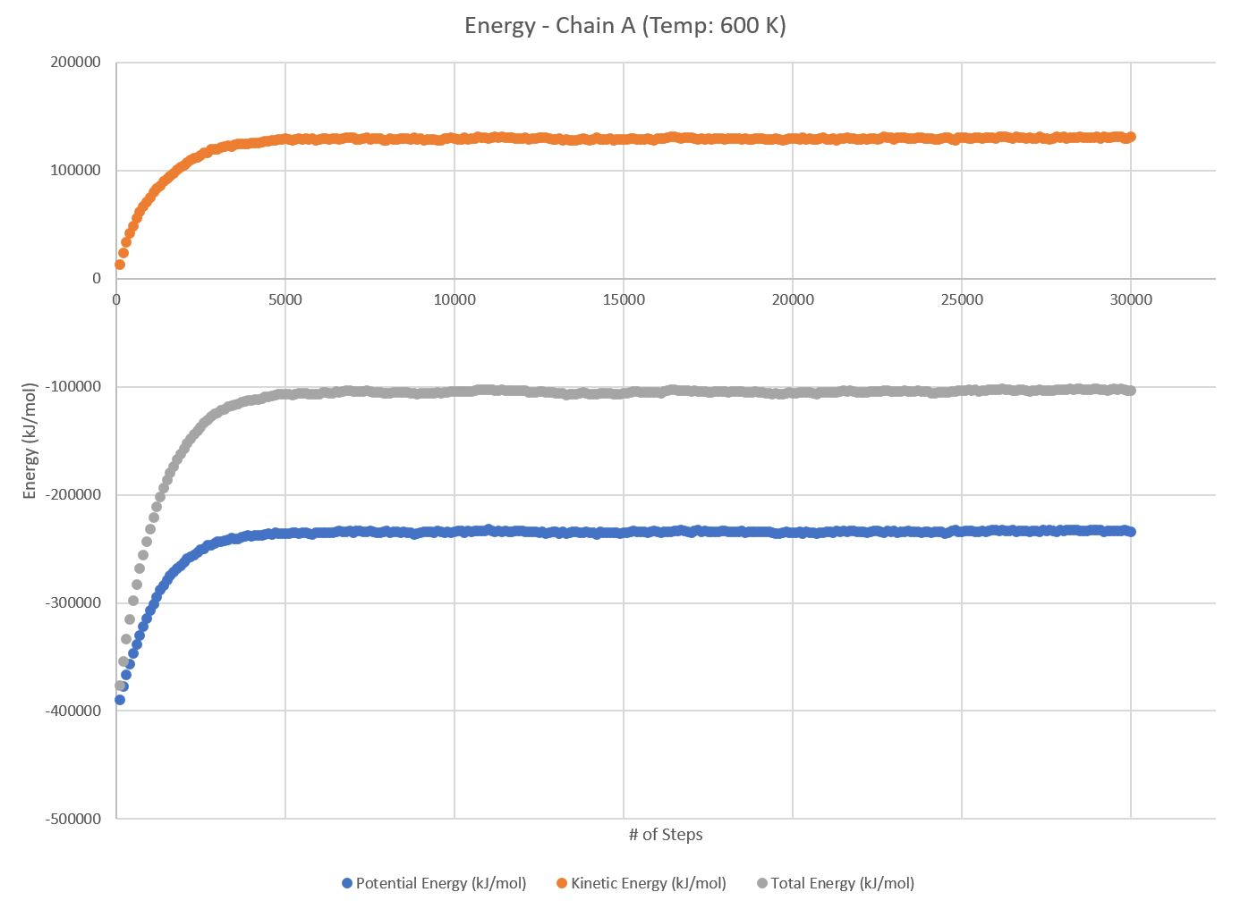

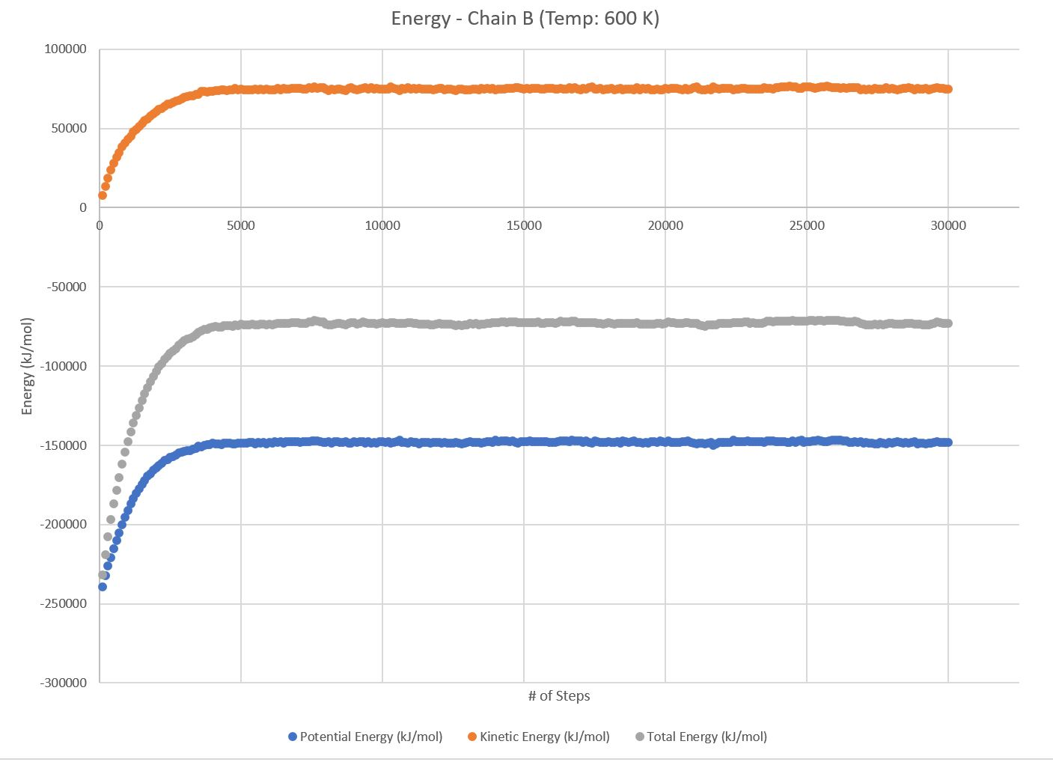






Test Case 4: TEMP: 600 K
Chains A and B:
All energies reach equilibrium around step 5500
Estimated Equilibrium Total Energy for Chains A and B: -102023.20 kJ
Chain A:
All energies reach equilibrium around step 5800
Estimated Equilibrium Total Energy for Chain A: -104639.49 kJ
Chain B:
All energies reach equilibrium around step 4600
Estimated Equilibrium Total Energy for Chain B: -72883.12 kJ
BE = Energy for (BCL-2) + Energy for (BIM-BH3) - Energy for complex (BCL-2-BIM-BH3)
-75499.41 = -104639.49 + -72883.12 - -102023.20
Binding Energy= -75499.41 kJ

Slide 10
ANALYSIS AND APPLICATIONS
Density remains constant throughout all cases with only slight variation
Best to have as low of a binding energy as possible
Interval sizes did not greatly affect results
Lower temperature = lower potential energy = lower binding energy
Further testing:
Continue altering temperature to determine optimal behavior
Although need to remember this takes place in human body
Manipulate chains’ locations and orders for better bonding
Manipulate residues molecule-by-molecule or atom-by-atom for better bonding
Target these proteins in order to learn more about uncontrolled cell death
Modify these proteins to target certain cells
Modify crystalline structure to allow for more inhibition or activation reactions
Notes:
Target mitochondria of fast-growing cells, like hair follicles, that are known not to be cancerous to prevent unneeded cell death

Slide 11
REFERENCES
Chipuk, J E, et al. “Mitochondrial Outer Membrane Permeabilization during Apoptosis: the Innocent Bystander Scenario.” Nature, Nature Publishing Group, 19 May 2006, www.nature.com/cdd/journal/v13/n8/full/4401963a.html?foxtrotcallback=true.
Rajan, Sreekanth, et al. “Bh3 Induced Conformational Changes in Bcl‐Xl Revealed by Crystal Structure and Comparative Analysis.” Wiley Online Library, Proteins: Structure, Function, and Bioinformatics, 23 May 2015, onlinelibrary.wiley.com/doi/10.1002/prot.24816/epdf?referrer_access_token=HDqstRRuisjo_yk2dKN MpE4keas67K9QMdWULTWMo8Mv2et5Yz-Tv2pP76vo2ZmVT3KqeaXvND-UqiK-dPIoAt0OBkYVmhIf9ze wmHZLptB53XEbya-6d1reGR47m6OBt_5dmURDwFt0HVLWRsQD3fsZtvOt3rKtkhBDzz3Gy3f5q5hdlmUF cQNLmXYjQK4L8iyda8ts8hWyCm5_RqiTHAE8-00TH6JRt-cTisRSaM%3D.
Rajan, Sreekanth, et al. “Bh3 Induced Conformational Changes in Bcl-Xl Revealed by Crystal Structure and Comparative Analysis.” Proteins, RCSB, 10 June 2015, www.rcsb.org/pdb/explore.do?structureId=4QVF.

